Slide 1
ENGINEERING CAPSTONE PROJECT | A.Y. 2026–2027
PROJECT REVIEW
REVIEW 3
AI-Assisted Data Visualization for
Business Decision Support Systems
Business Analytics & Decision Support Systems
G. Harshavardhan Reddy • Ch. Sai Nikhil Reddy
T. Sai Satwik • V. Satya Dev
Under the guidance of Dr. Swapnika | KLH University
01

Slide 2
REVIEW 3: PURPOSE AND EVIDENCE
A results-led review, with earlier reviews condensed into the necessary background.
Methodology
Model study
Results
Validate data processing and experimental design.
Relate published methods to baselines and multiple hybrid candidates.
Show actual saved tables, figures and metrics from project outputs.
Decision support
Readiness
Connect prediction, explainability and business findings.
Identify what is implemented and what still needs final verification.
Faculty sequence: literature → baselines → limitations → multiple hybrid candidates → comparison → justified conclusion
REVIEW 3 | AI-ASSISTED DATA VISUALIZATION FOR BUSINESS DECISION SUPPORT
02

Slide 3
PROBLEM STATEMENT AND MOTIVATION
Carry forward the original problem while emphasizing completed implementation.
Problem
Motivation
Business datasets contain complex interactions between sales, discount, products, geography and profit. Descriptive dashboards alone do not predict outcomes or explain why a model makes a prediction.
A useful business decision-support system should combine data quality checks, predictive modelling, explainability and readable visual outputs in one workflow.
• Support profit prediction on two transaction datasets.
• Explore customer geography on the supplied Olist customer-location file.
• Evaluate multiple model families and hybrid candidates using measurable metrics.
• Translate analysis into dashboard outputs and business recommendations.
REVIEW 3 | AI-ASSISTED DATA VISUALIZATION FOR BUSINESS DECISION SUPPORT
03

Slide 4
RESEARCH OBJECTIVES AND QUESTIONS
Objectives
Research questions
1. Build repeatable cleaning and EDA workflows.
2. Engineer/select features while avoiding target leakage.
3. Compare regression baselines and hybrid candidates.
4. Evaluate geographic clustering on D3.
5. Explain predictions and expose findings through a dashboard.
RQ1: Which baseline performs best for profit prediction?
RQ2: Do tested hybrid combinations improve on the strongest baseline?
RQ3: Which features most influence model predictions?
RQ4: Can the available customer-location data produce interpretable geographic clusters?
REVIEW 3 | AI-ASSISTED DATA VISUALIZATION FOR BUSINESS DECISION SUPPORT
04

Slide 5
PROJECT PROGRESSION: REVIEW 1 → REVIEW 2 → REVIEW 3
REVIEW 1
REVIEW 2
REVIEW 3
Problem definition, objectives, dataset identification, literature themes and proposed system.
Cleaning, EDA, feature engineering, initial baselines, model explanations and dashboard groundwork.
Experimental validation, model/hybrid comparison, output evidence, result interpretation and research-paper alignment.
→
→
Review 3 is the main story; previous work appears only where it supports the evidence.
REVIEW 3 | AI-ASSISTED DATA VISUALIZATION FOR BUSINESS DECISION SUPPORT
05

Slide 6
SYSTEM ARCHITECTURE AND ANALYTICAL FLOW
Data
Quality
EDA
Features
Models
Evaluation
XAI
DSS
D1, D2, D3
›
types, nulls,
duplicates
›
distributions,
relationships
›
engineering +
selection
›
regression /
clustering
›
metrics +
comparisons
›
importance +
explanations
›
dashboard +
actions
D1/D2 use profit as the regression target. D3 uses geographic customer segmentation because transaction-level behaviour is not present in the supplied file.
REVIEW 3 | AI-ASSISTED DATA VISUALIZATION FOR BUSINESS DECISION SUPPORT
06

Slide 7
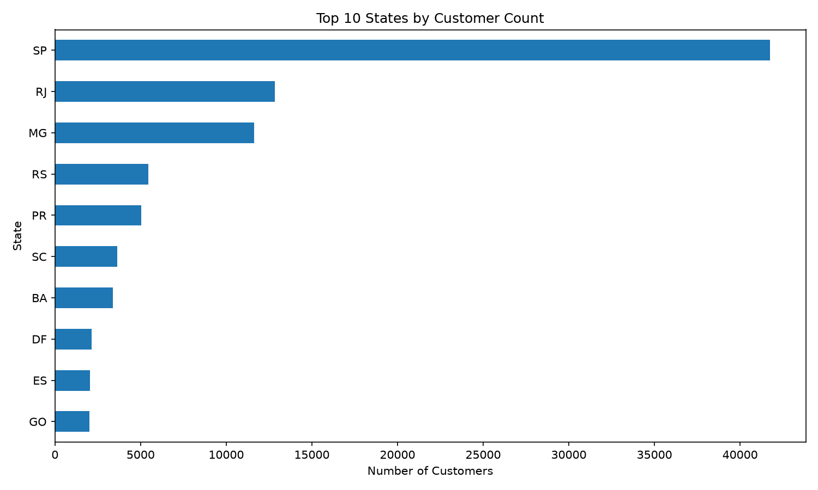
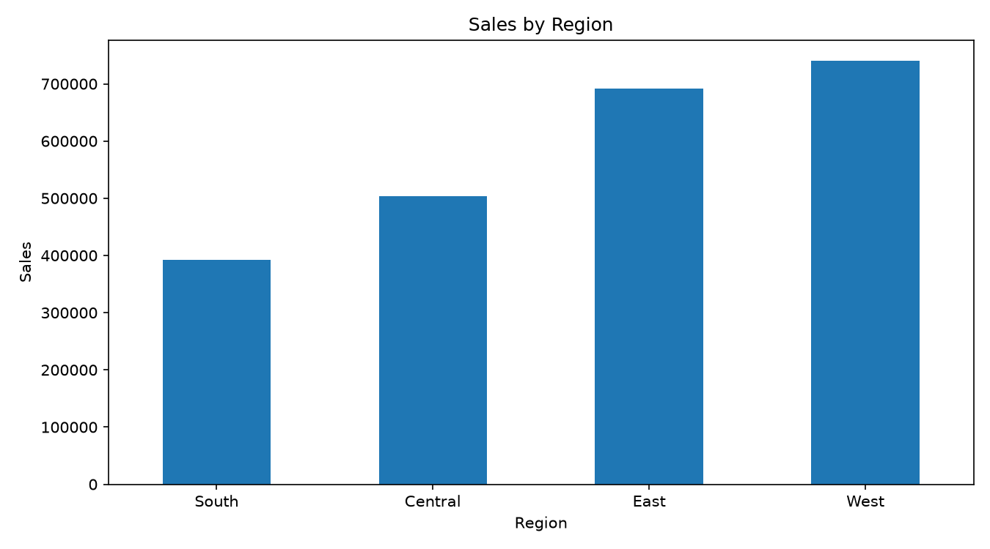
DATASET OVERVIEW AND TASK ASSIGNMENT
Dataset | Rows in cleaned file | Key available fields | Task | Constraint
D1 • Superstore | 10,194 | sales, profit, discount, quantity, category, region, dates | Profit regression | Avoid using profit_margin as predictor.
D2 • Global Superstore | 51,290 | sales, profit, discount, quantity, market, region, shipping | Profit regression | Different dataset scale and distribution.
D3 • Olist customers | 99,441 | customer ID, ZIP prefix, city, state | Geographic segmentation | No order/payment/profit tables supplied.
The D3 task is intentionally limited to geographic segmentation; RFM and profit prediction are not supported by the available file.
D3: customer records by state
D1: sales by region
REVIEW 3 | AI-ASSISTED DATA VISUALIZATION FOR BUSINESS DECISION SUPPORT
07

Slide 8
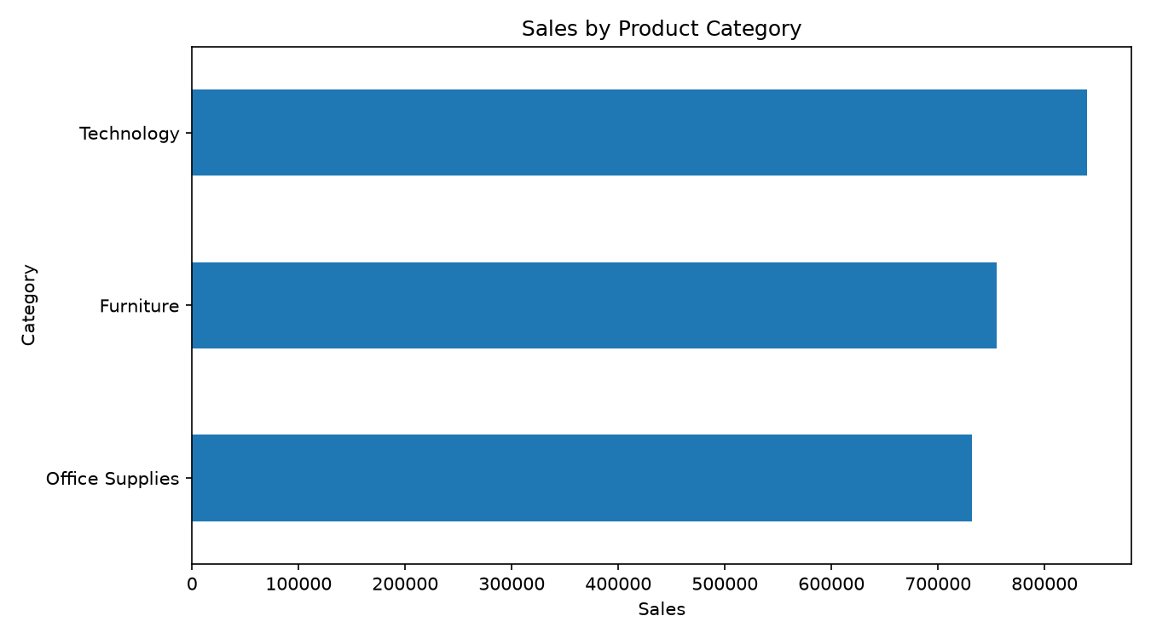
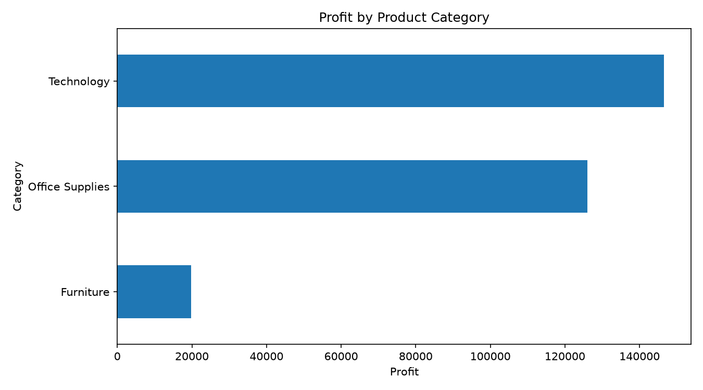
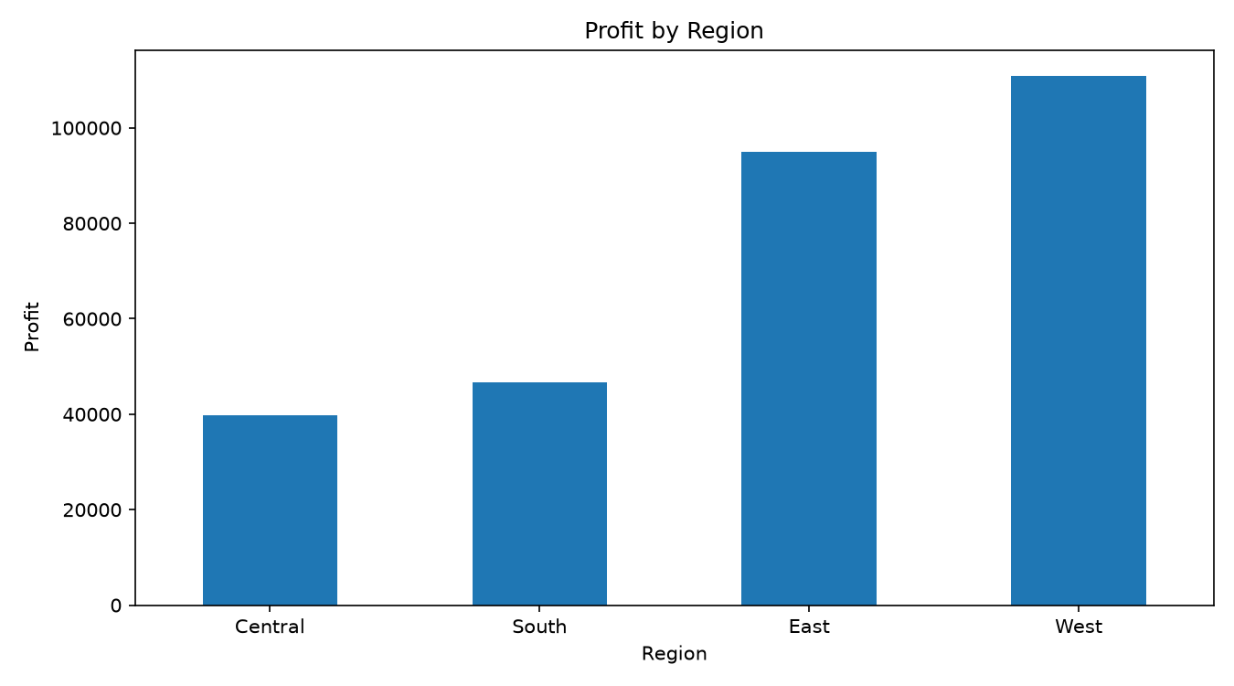
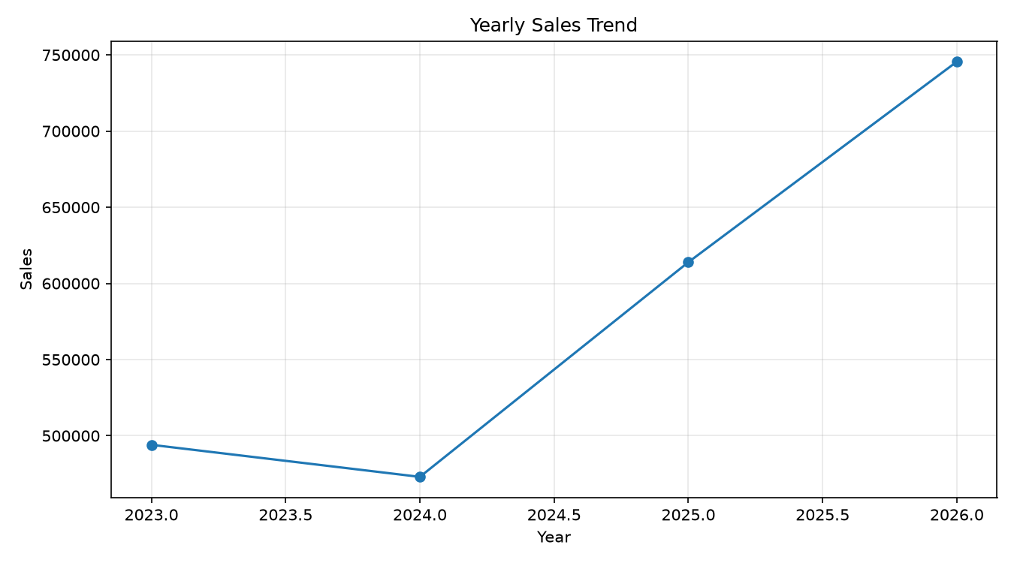
D1 DATA PROFILE: SUPERSTORE
Actual output figures from the project's figures folder.
Sales by category
Profit by category
Profit by region
Yearly sales trend
REVIEW 3 | AI-ASSISTED DATA VISUALIZATION FOR BUSINESS DECISION SUPPORT
08

Slide 9
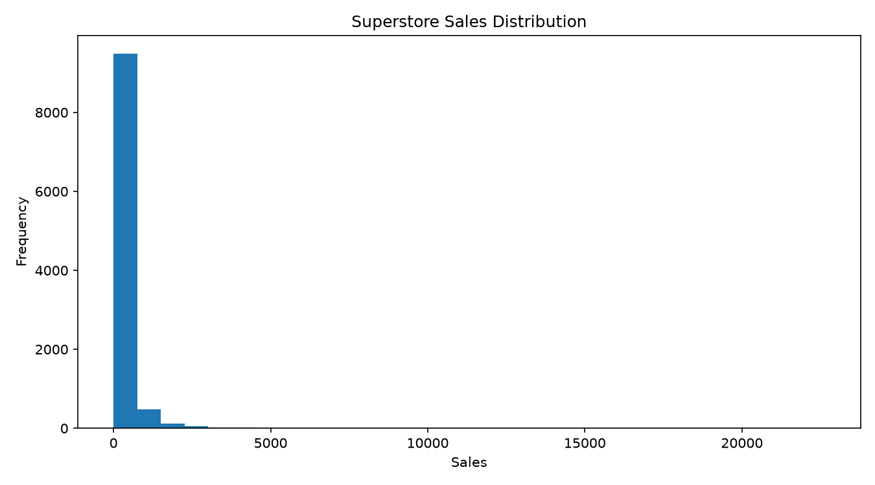
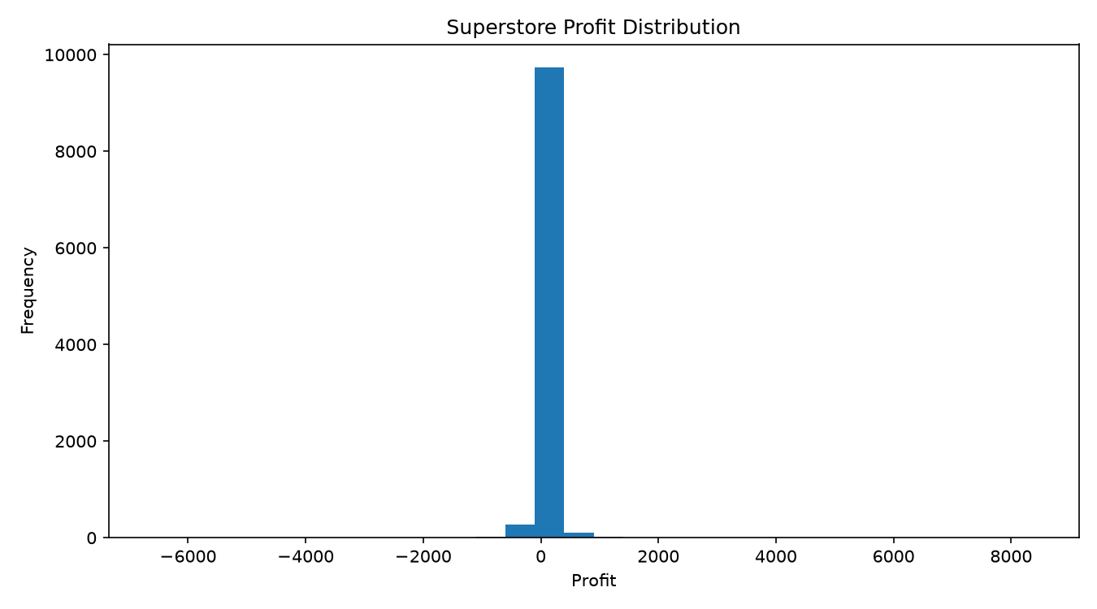
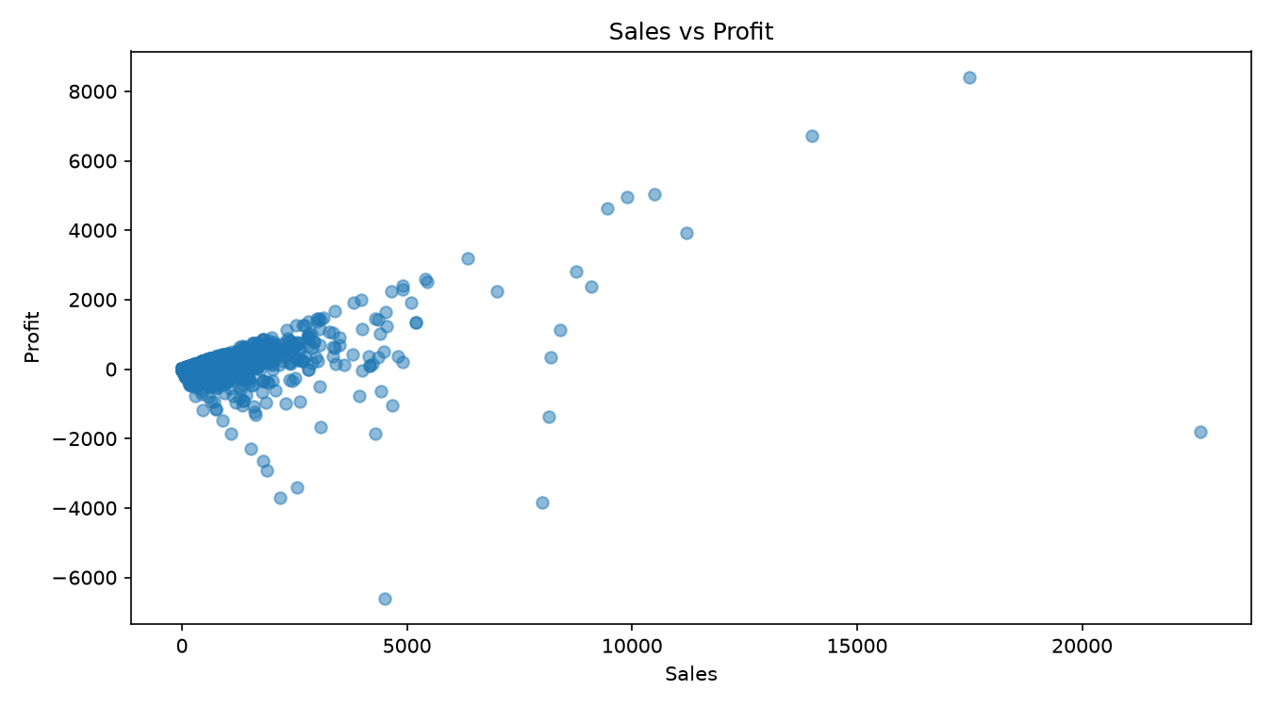
D1 DISTRIBUTIONS AND RELATIONSHIPS
Sales distribution
Profit distribution
Sales versus profit
Interpretation: inspect skew, outliers and the relationship between sales and profit before model selection.
REVIEW 3 | AI-ASSISTED DATA VISUALIZATION FOR BUSINESS DECISION SUPPORT
09

Slide 10
D1 CORRELATION ANALYSIS
Variable | sales | profit | quantity | discount
sales | 1.000 | 0.481 | 0.198 | -0.028
profit | 0.481 | 1.000 | 0.066 | -0.219
quantity | 0.198 | 0.066 | 1.000 | 0.007
discount | -0.028 | -0.219 | 0.007 | 1.000
Sales–profit correlation
The saved correlation matrix reports approximately 0.481 between sales and profit.
Discount–profit correlation
The saved matrix reports approximately −0.218 between discount and profit.
Correlation is descriptive association; it does not establish causation and does not capture all nonlinear relationships.
REVIEW 3 | AI-ASSISTED DATA VISUALIZATION FOR BUSINESS DECISION SUPPORT
10

Slide 11
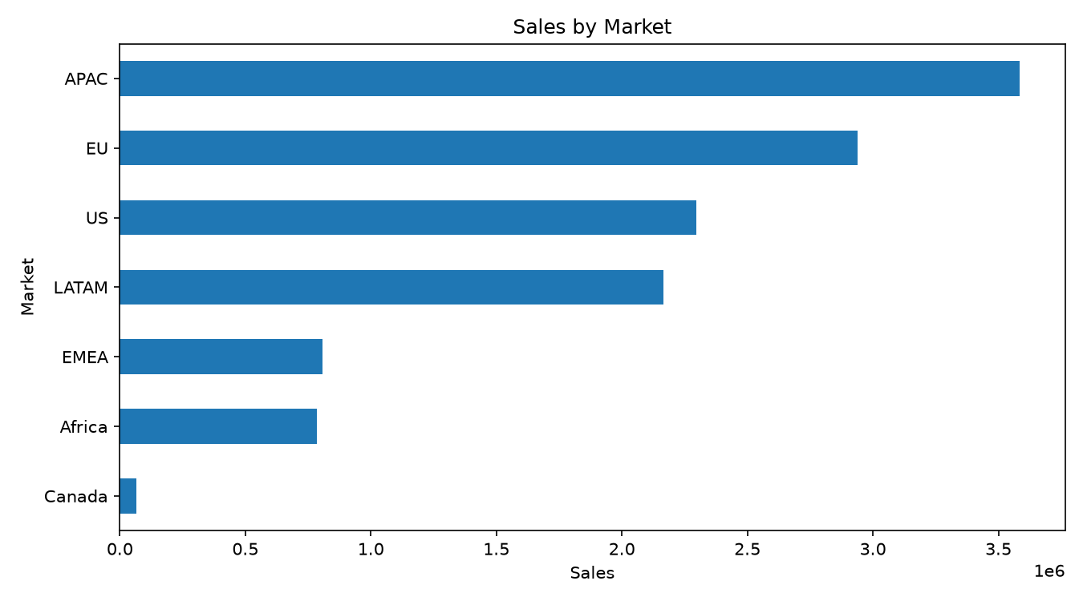
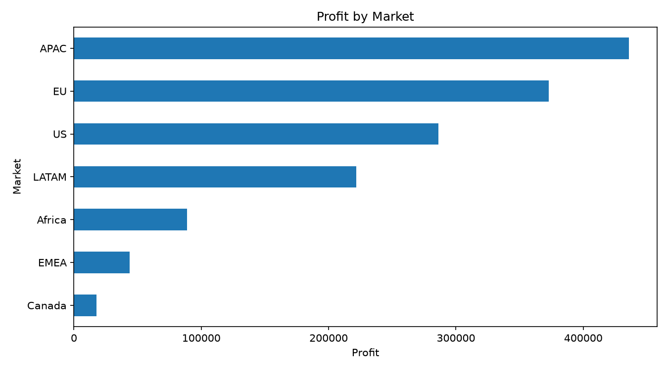
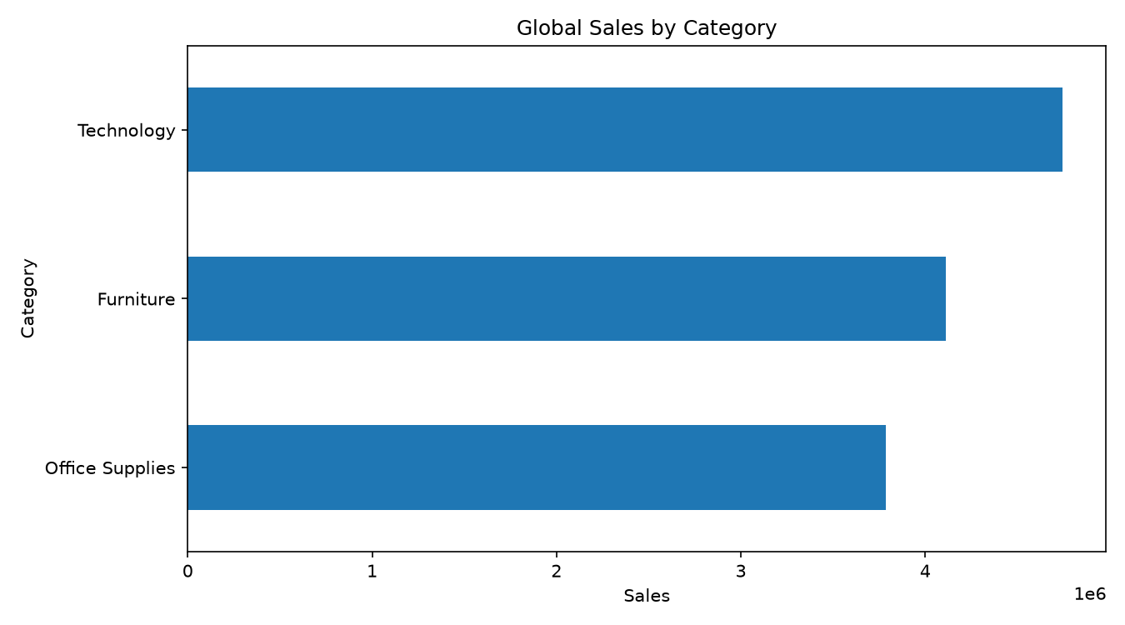
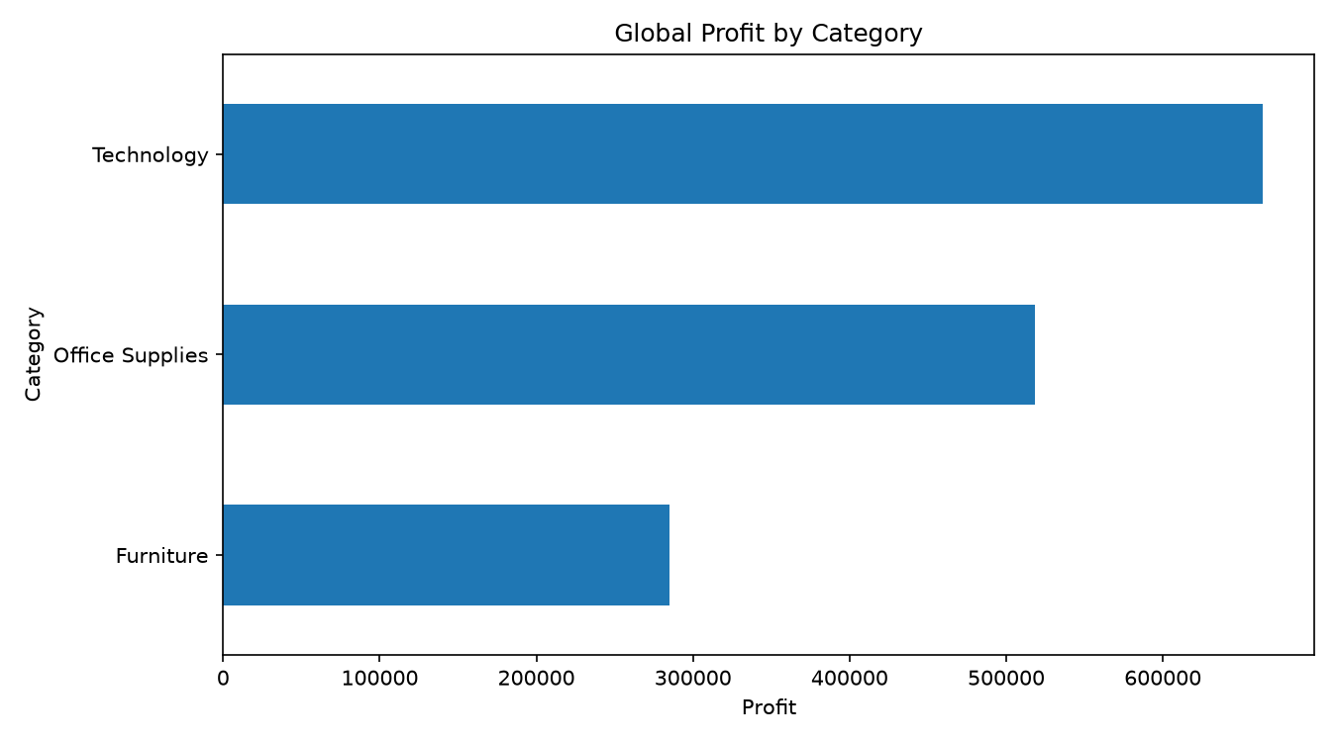
D2 DATA PROFILE: GLOBAL SUPERSTORE
Sales by market
Profit by market
Sales by category
Profit by category
REVIEW 3 | AI-ASSISTED DATA VISUALIZATION FOR BUSINESS DECISION SUPPORT
11

Slide 12
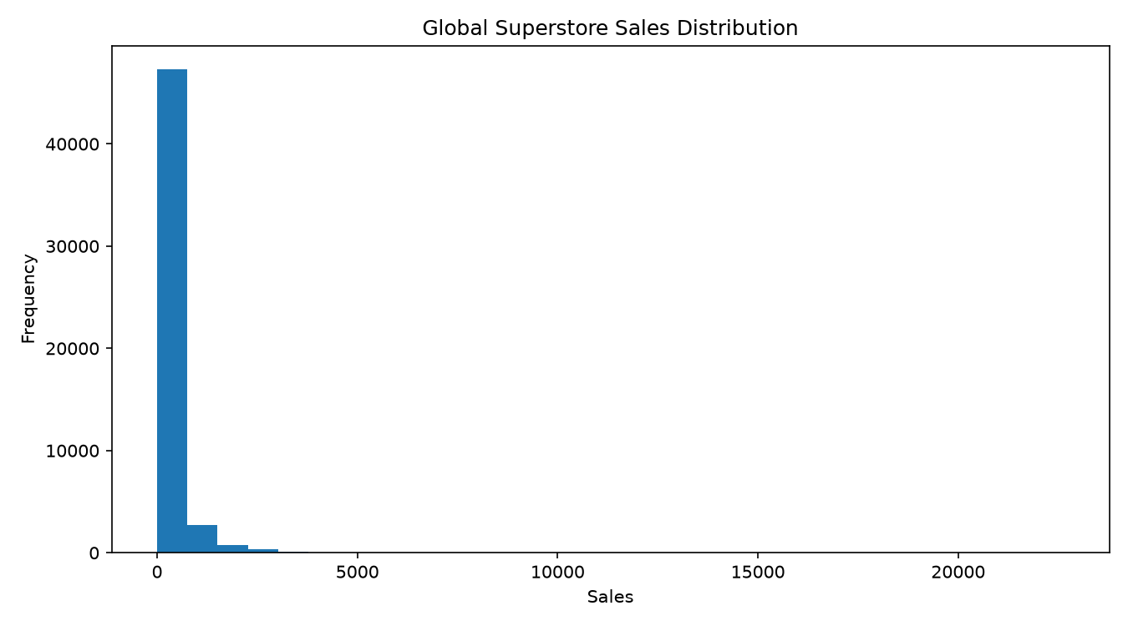
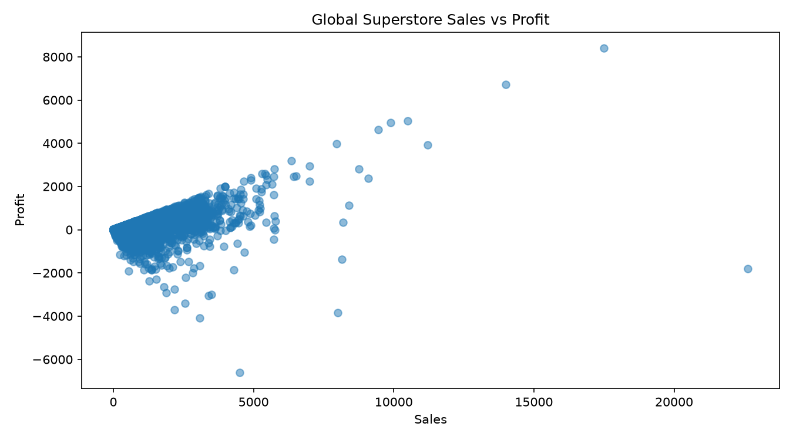
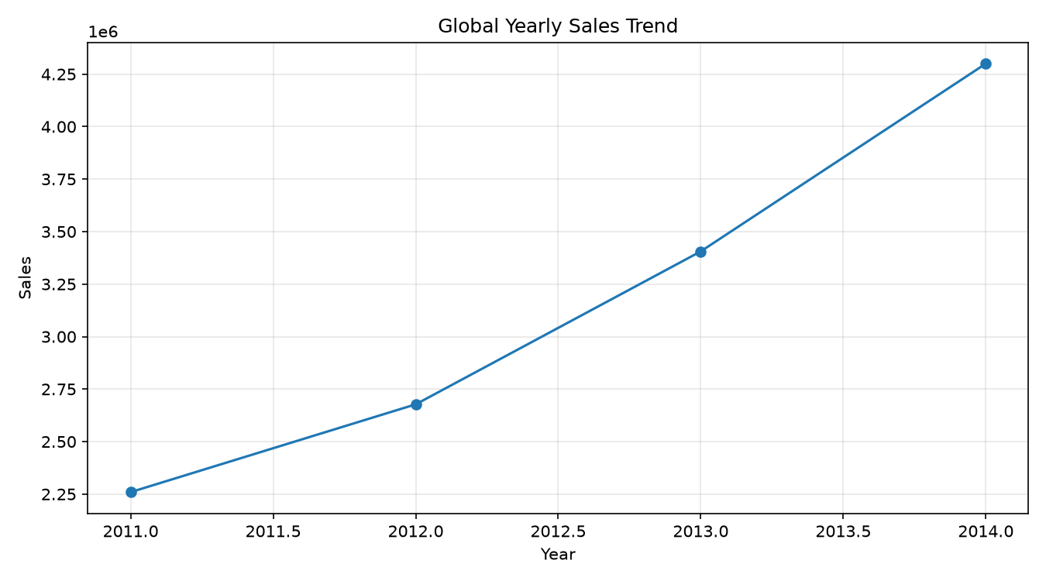
D2 DISTRIBUTIONS AND TIME TREND
Global sales distribution
Global sales versus profit
Global yearly sales
REVIEW 3 | AI-ASSISTED DATA VISUALIZATION FOR BUSINESS DECISION SUPPORT
12

Slide 13
D2 CORRELATION ANALYSIS
Variable | sales | profit | quantity | discount | shipping_cost
sales | 1.000 | 0.485 | 0.314 | -0.087 | 0.768
profit | 0.485 | 1.000 | 0.104 | -0.316 | 0.354
quantity | 0.314 | 0.104 | 1.000 | -0.020 | 0.273
discount | -0.087 | -0.316 | -0.020 | 1.000 | -0.079
shipping_cost | 0.768 | 0.354 | 0.273 | -0.079 | 1.000
Sales–profit
Saved correlation: approximately 0.485.
Discount–profit
Saved correlation: approximately −0.316.
The D2 discount–profit association is more negative than in D1 in the saved matrices; this is descriptive, not causal.
REVIEW 3 | AI-ASSISTED DATA VISUALIZATION FOR BUSINESS DECISION SUPPORT
13

Slide 14
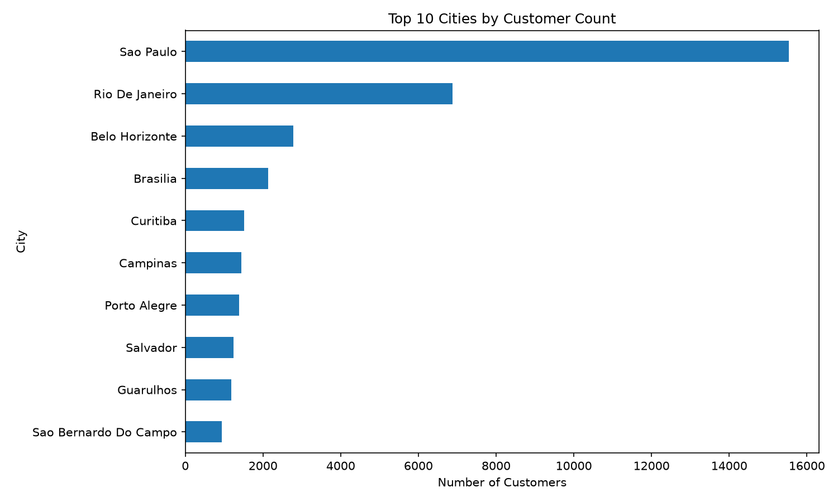
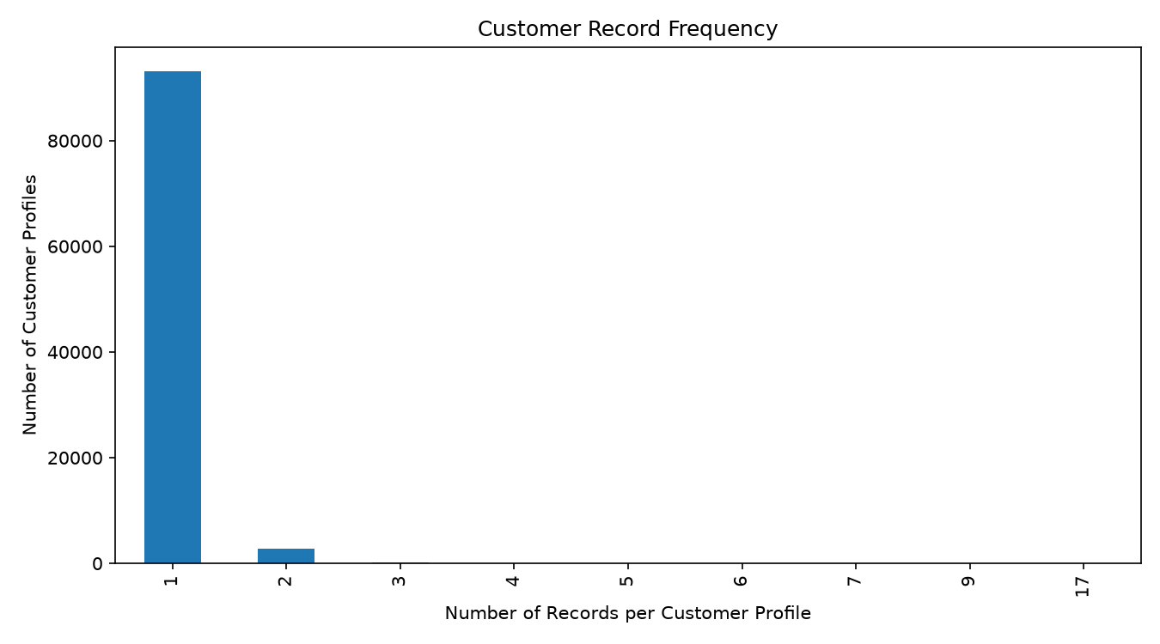
D3 CUSTOMER-GEOGRAPHIC PROFILE
Customers by state
Customers by city
Customer record frequency/profile
Only customer location fields are available in this project dataset; customer behaviour cannot be inferred from these fields alone.
REVIEW 3 | AI-ASSISTED DATA VISUALIZATION FOR BUSINESS DECISION SUPPORT
14

Slide 15
PREPROCESSING AND FEATURE ENGINEERING
Quality checks
Engineered features
Model preparation
• Inspect schema and data types
• Handle missing target values
• Identify duplicates/outliers
• Standardize column names
• shipping_days
• order_year
• order_month
• profit_margin for analysis only
• Numeric imputation
• Categorical encoding
• Scale geographic features for clustering
• Separate train/validation/test
Leakage safeguard: profit_margin is derived from profit and is excluded from profit prediction features.
REVIEW 3 | AI-ASSISTED DATA VISUALIZATION FOR BUSINESS DECISION SUPPORT
15

Slide 16
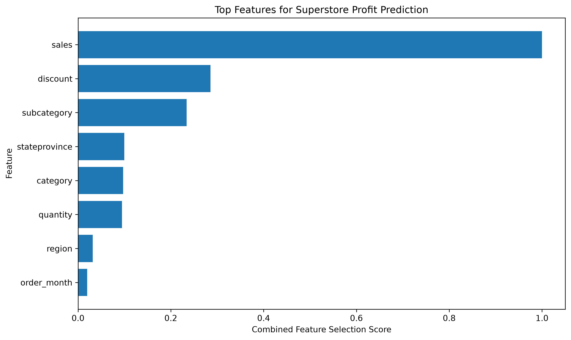
FEATURE SELECTION: MUTUAL INFORMATION + RANDOM FOREST
Rank | Feature | MI | RF importance | Combined
1 | sales | 2.053 | 0.616 | 1.000
2 | discount | 0.482 | 0.207 | 0.285
3 | subcategory | 0.776 | 0.056 | 0.234
4 | stateprovince | 0.292 | 0.035 | 0.099
5 | category | 0.361 | 0.012 | 0.097
6 | quantity | 0.356 | 0.010 | 0.095
7 | region | 0.078 | 0.016 | 0.032
8 | order_month | 0.030 | 0.015 | 0.020
Saved feature-selection visualization
Selected D1 predictors: sales, discount, subcategory, state/province, category, quantity, region and order_month.
REVIEW 3 | AI-ASSISTED DATA VISUALIZATION FOR BUSINESS DECISION SUPPORT
16

Slide 17
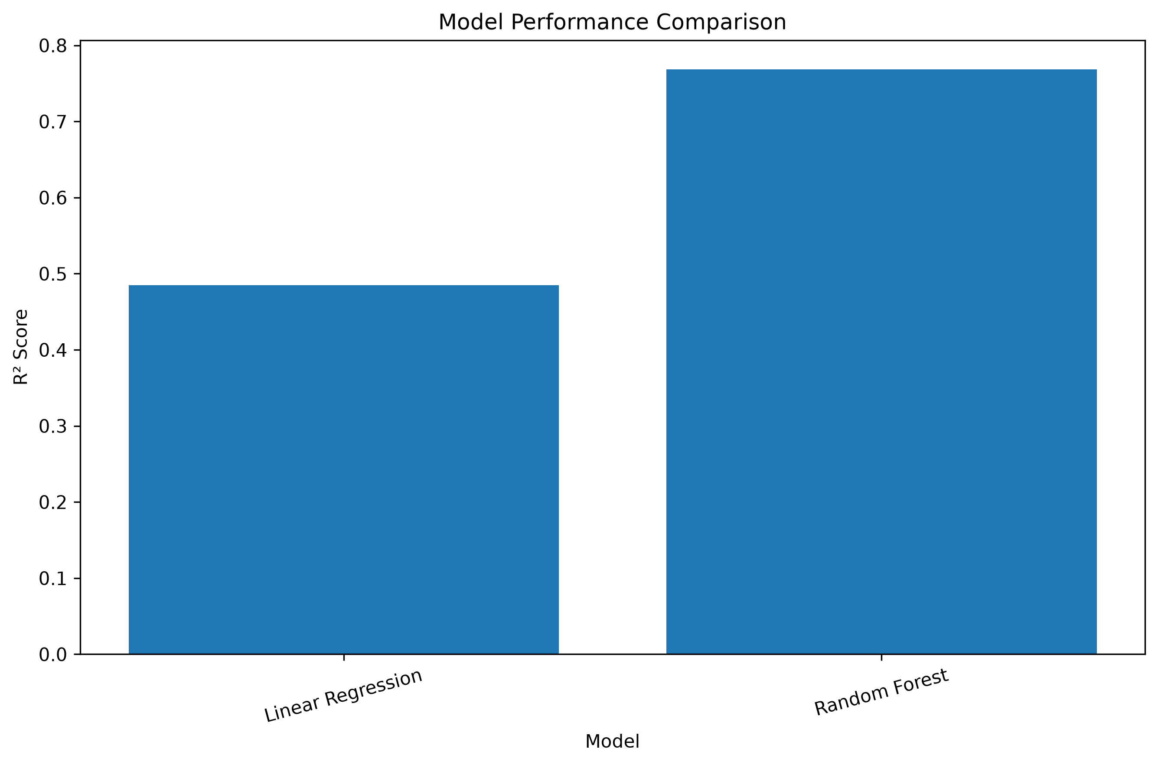
INITIAL BASELINE MODEL COMPARISON
Earlier baseline results saved in model_metrics/model_comparison.csv.
Model | MAE ↓ | RMSE ↓ | R² ↑
Linear Regression | 62.30 | 214.96 | 0.485
Random Forest | 21.10 | 144.13 | 0.768
Observation
Caution
Saved baseline comparison plot
Random Forest reduced MAE substantially compared with Linear Regression in this initial run.
These initial results are from an earlier experiment and should not be mixed with later split-specific comparisons without noting the experiment setup.
REVIEW 3 | AI-ASSISTED DATA VISUALIZATION FOR BUSINESS DECISION SUPPORT
17

Slide 18
LITERATURE REVIEW: MODEL FORMATION AND COMPARISON
Faculty requirement: explain how each study formed its model, what it compared, and its limitations.
Study | Model formation | Comparison | Limitation / relevance
Lessmann et al. (2021) | Profit-oriented customer targeting; ensemble learning framework across 25 marketing datasets. | Compares ensemble decision-support approaches. | Different target/task; informs business-aware model evaluation.
Retail firm performance (2023) | Regression and ML approaches for retail-firm performance/profitability. | Compares multiple model families. | Different data granularity and target context.
Multi-channel retail forecasting (2022) | RF–XGBoost–Linear Regression hybrid. | Hybrid against standalone forecasting models. | Demand forecasting, not transaction-level profit.
Retail demand prediction (2023) | Tree ensembles compared with LSTM. | Model-family comparison for retail demand. | Temporal demand task differs from profit prediction.
RF + Gradient Boosting hybrid (2026) | Voting/averaging and stacking variants in regression. | Compares combination mechanisms. | Different domain; simple RF+GB combinations are not novel by themselves.
Key takeaway: hybrid novelty must come from a verified method contribution—not merely naming a combination of familiar models.
REVIEW 3 | AI-ASSISTED DATA VISUALIZATION FOR BUSINESS DECISION SUPPORT
18

Slide 19
RESEARCH GAP AND PROJECT-SPECIFIC CONTRIBUTION
Integration gap
Evaluation gap
Bring cleaning, prediction, explainability and dashboard decision support into one reproducible workflow.
Compare multiple baseline and hybrid candidates on consistent data partitions.
Selection gap
Interpretability gap
Use validation results to choose combinations and report held-out test results.
Connect feature importance and descriptive findings to business questions.
Contribution claim remains provisional until final literature novelty verification is complete.
REVIEW 3 | AI-ASSISTED DATA VISUALIZATION FOR BUSINESS DECISION SUPPORT
19

Slide 20
EXPERIMENTAL DESIGN AND EVALUATION METRICS
Baselines
Hybrid candidates
Metrics
• Naive mean predictor
• Ridge Regression
• Random Forest
• Gradient Boosting
• Random Forest on selected features
• RF + GB blend
• Ridge + RF / Ridge + GB blends
• GB + Ridge residual correction
• Three-model ensemble
• Validation-optimized ensemble
• MAE — typical absolute error
• RMSE — penalizes large errors
• MAPE / sMAPE — percentage error
• R² — explained variance
• Average rank — summary, not significance test
Model selection must use validation data; the held-out test set is for final reporting.
REVIEW 3 | AI-ASSISTED DATA VISUALIZATION FOR BUSINESS DECISION SUPPORT
20

Slide 21
D1 RESULTS: COMPARATIVE PROFIT REGRESSION
Values transcribed from results/d1_comparative_model_results.csv.
Model | MAE ↓ | RMSE ↓ | sMAPE ↓ | R² ↑ | Avg rank
Gradient Boosting | 21.70 | 93.73 | 53.52% | 0.837 | 1.40
Hybrid 1 - RF + GB | 24.50 | 102.28 | 57.05% | 0.806 | 2.40
Hybrid 6 - GB + Ridge Residual Correction | 27.42 | 92.70 | 85.42% | 0.840 | 3.40
Random Forest - Selected Features | 30.62 | 130.49 | 61.91% | 0.684 | 4.90
Hybrid 5 - Validation Optimized Ensemble | 30.62 | 130.49 | 61.91% | 0.684 | 4.90
Hybrid 4 - RF + GB + Ridge | 33.12 | 113.74 | 90.63% | 0.760 | 5.60
Hybrid 3 - Ridge + GB | 36.83 | 114.47 | 100.66% | 0.757 | 6.60
Random Forest | 38.32 | 147.05 | 78.13% | 0.599 | 7.20
In this saved comparison, Gradient Boosting is the strongest overall baseline; the RF+GB hybrid is the best genuine hybrid by average rank.
REVIEW 3 | AI-ASSISTED DATA VISUALIZATION FOR BUSINESS DECISION SUPPORT
21

Slide 22
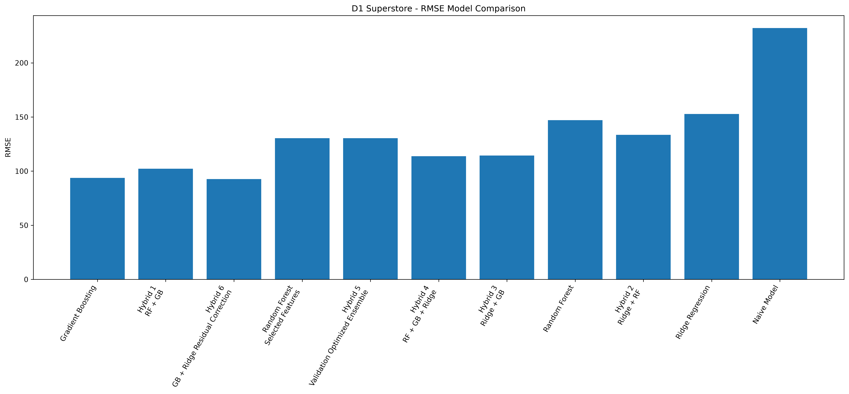
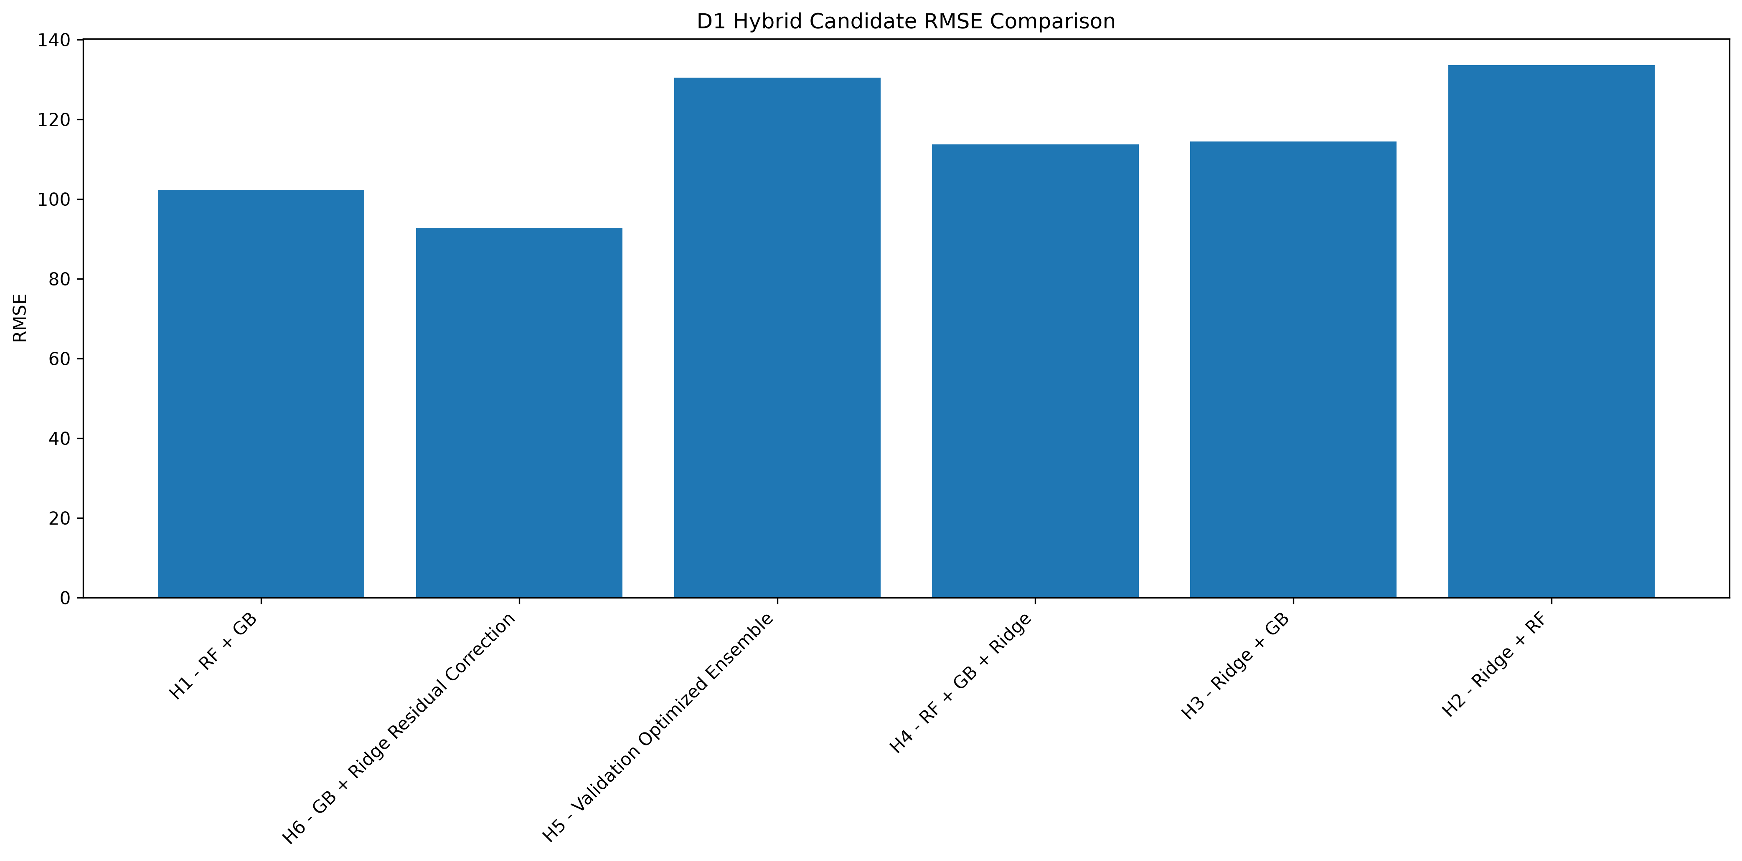
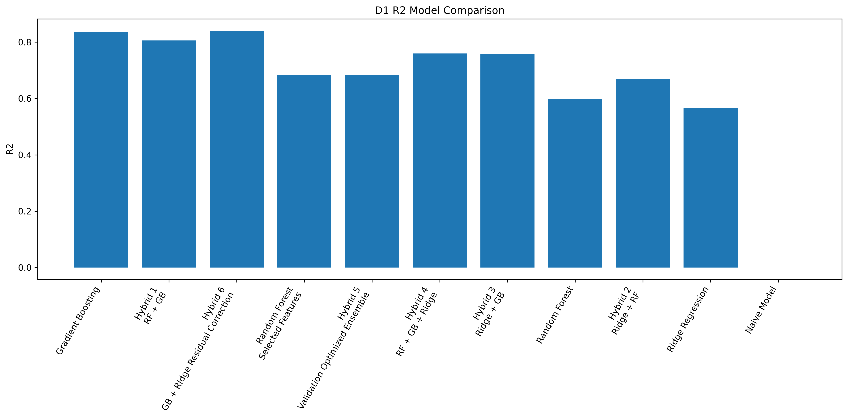
D1 RESULTS: MODEL COMPARISON VISUALS
D1 comparative metrics
D1 hybrid candidate comparison
D1 R² comparison
REVIEW 3 | AI-ASSISTED DATA VISUALIZATION FOR BUSINESS DECISION SUPPORT
22

Slide 23
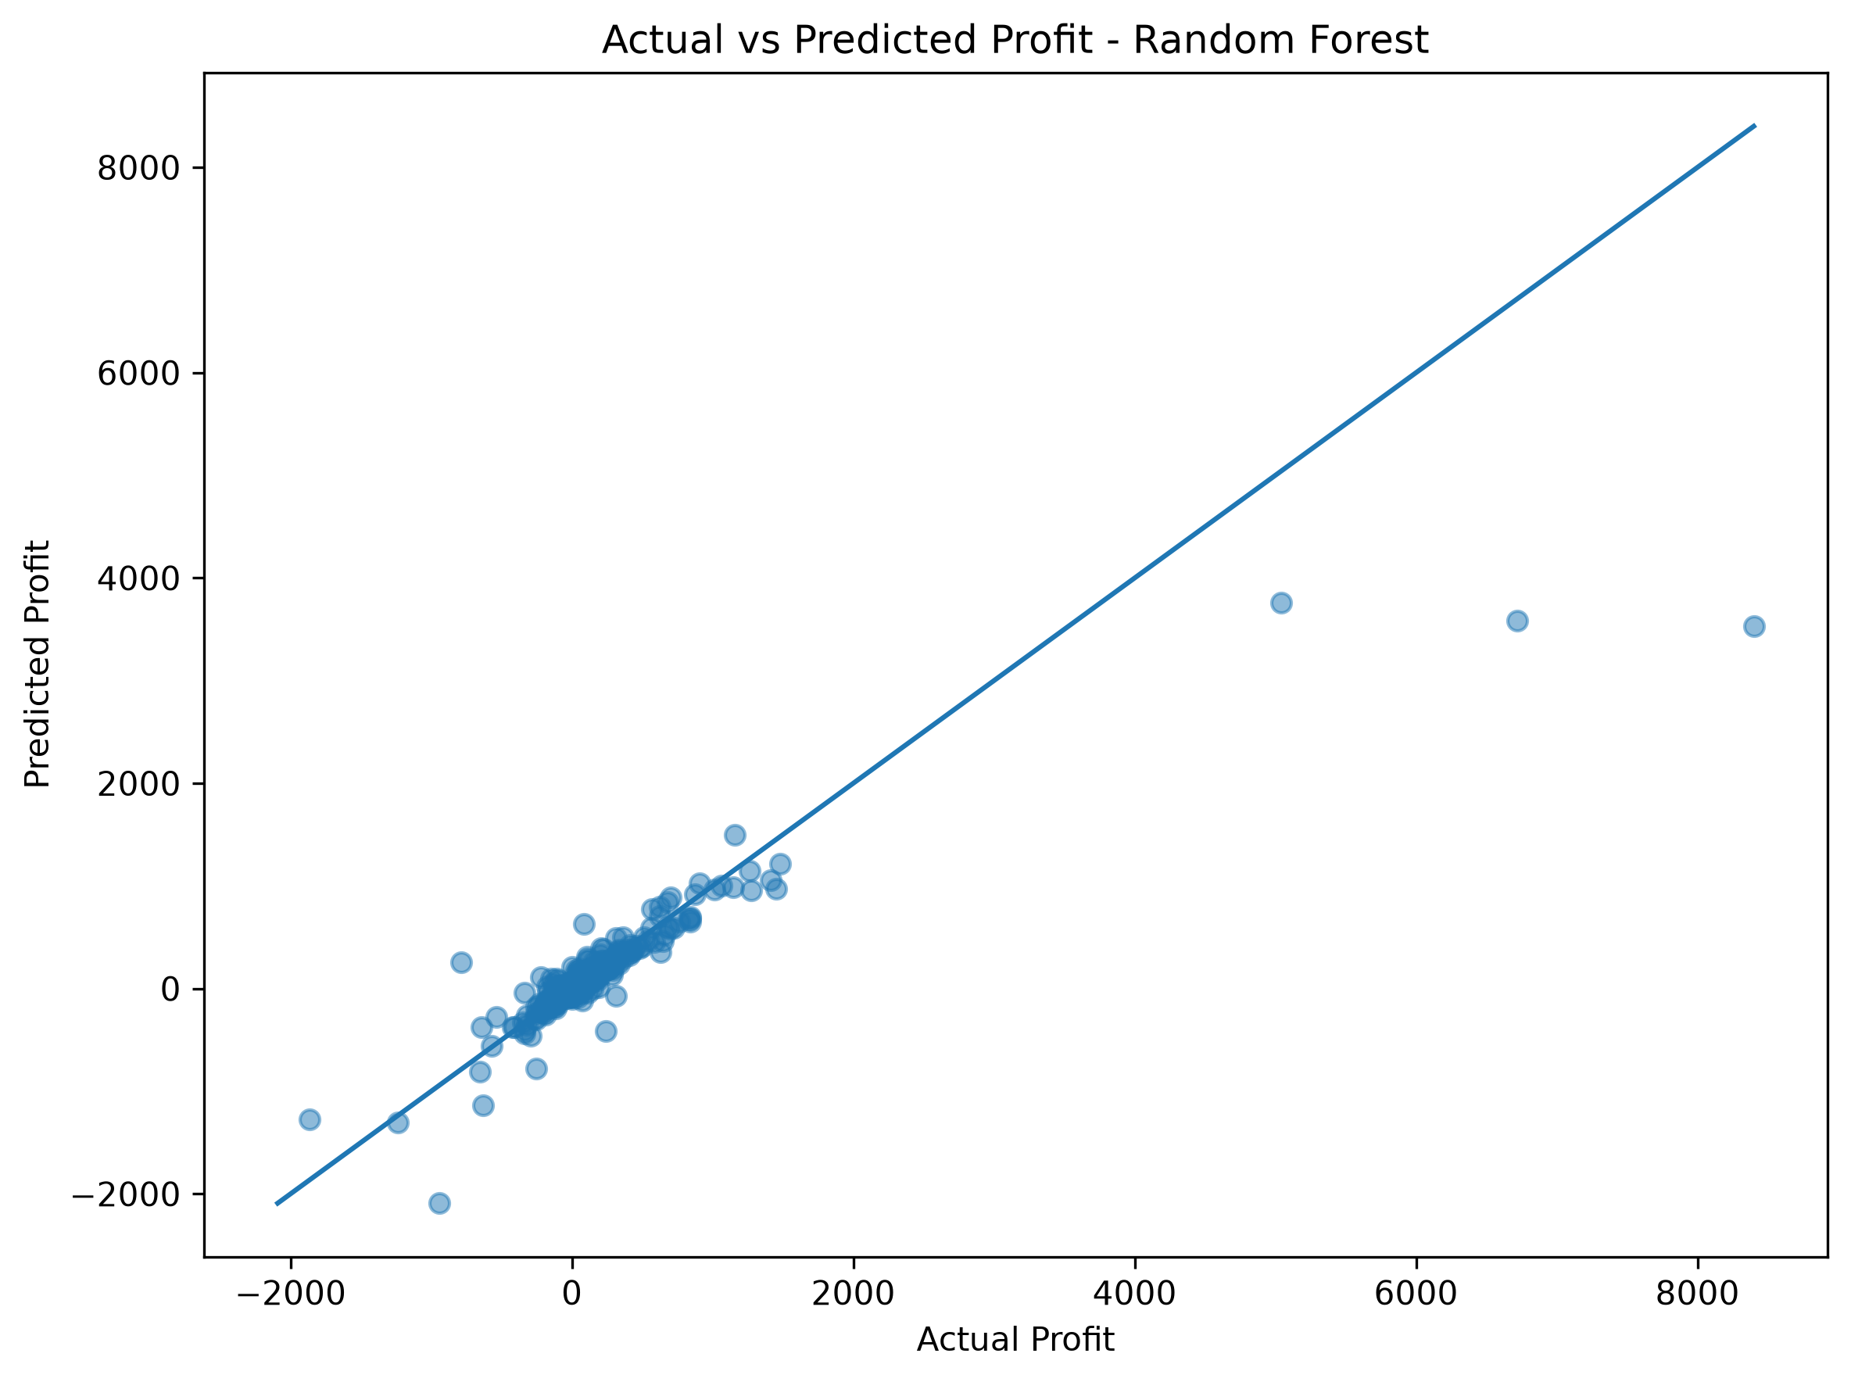
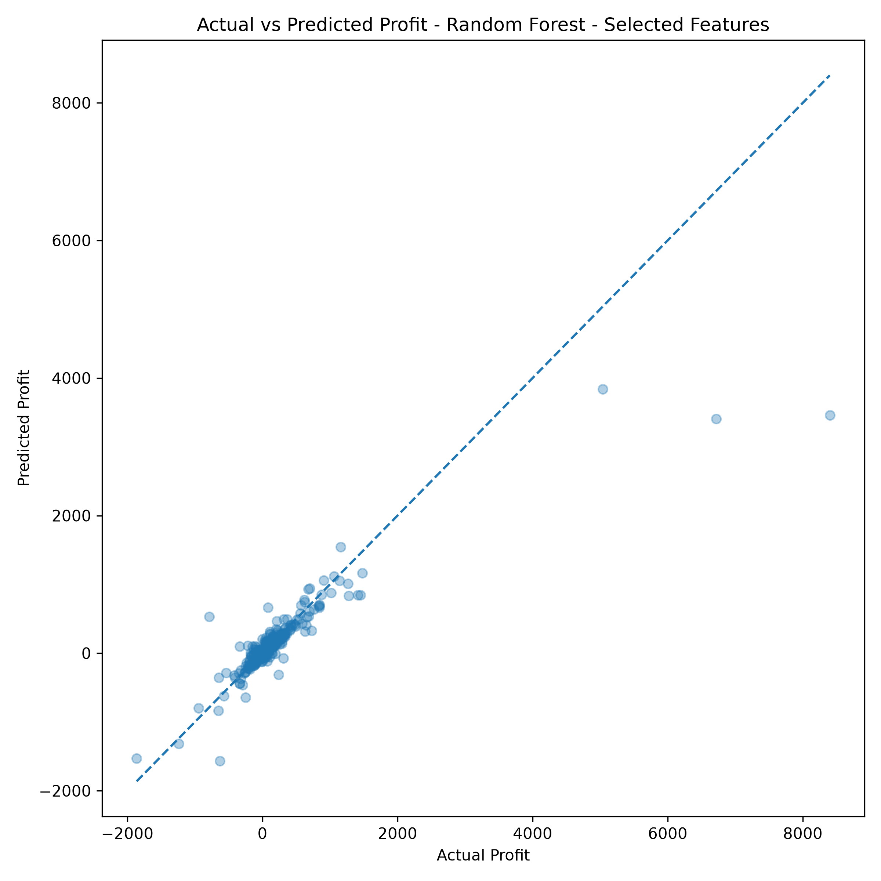
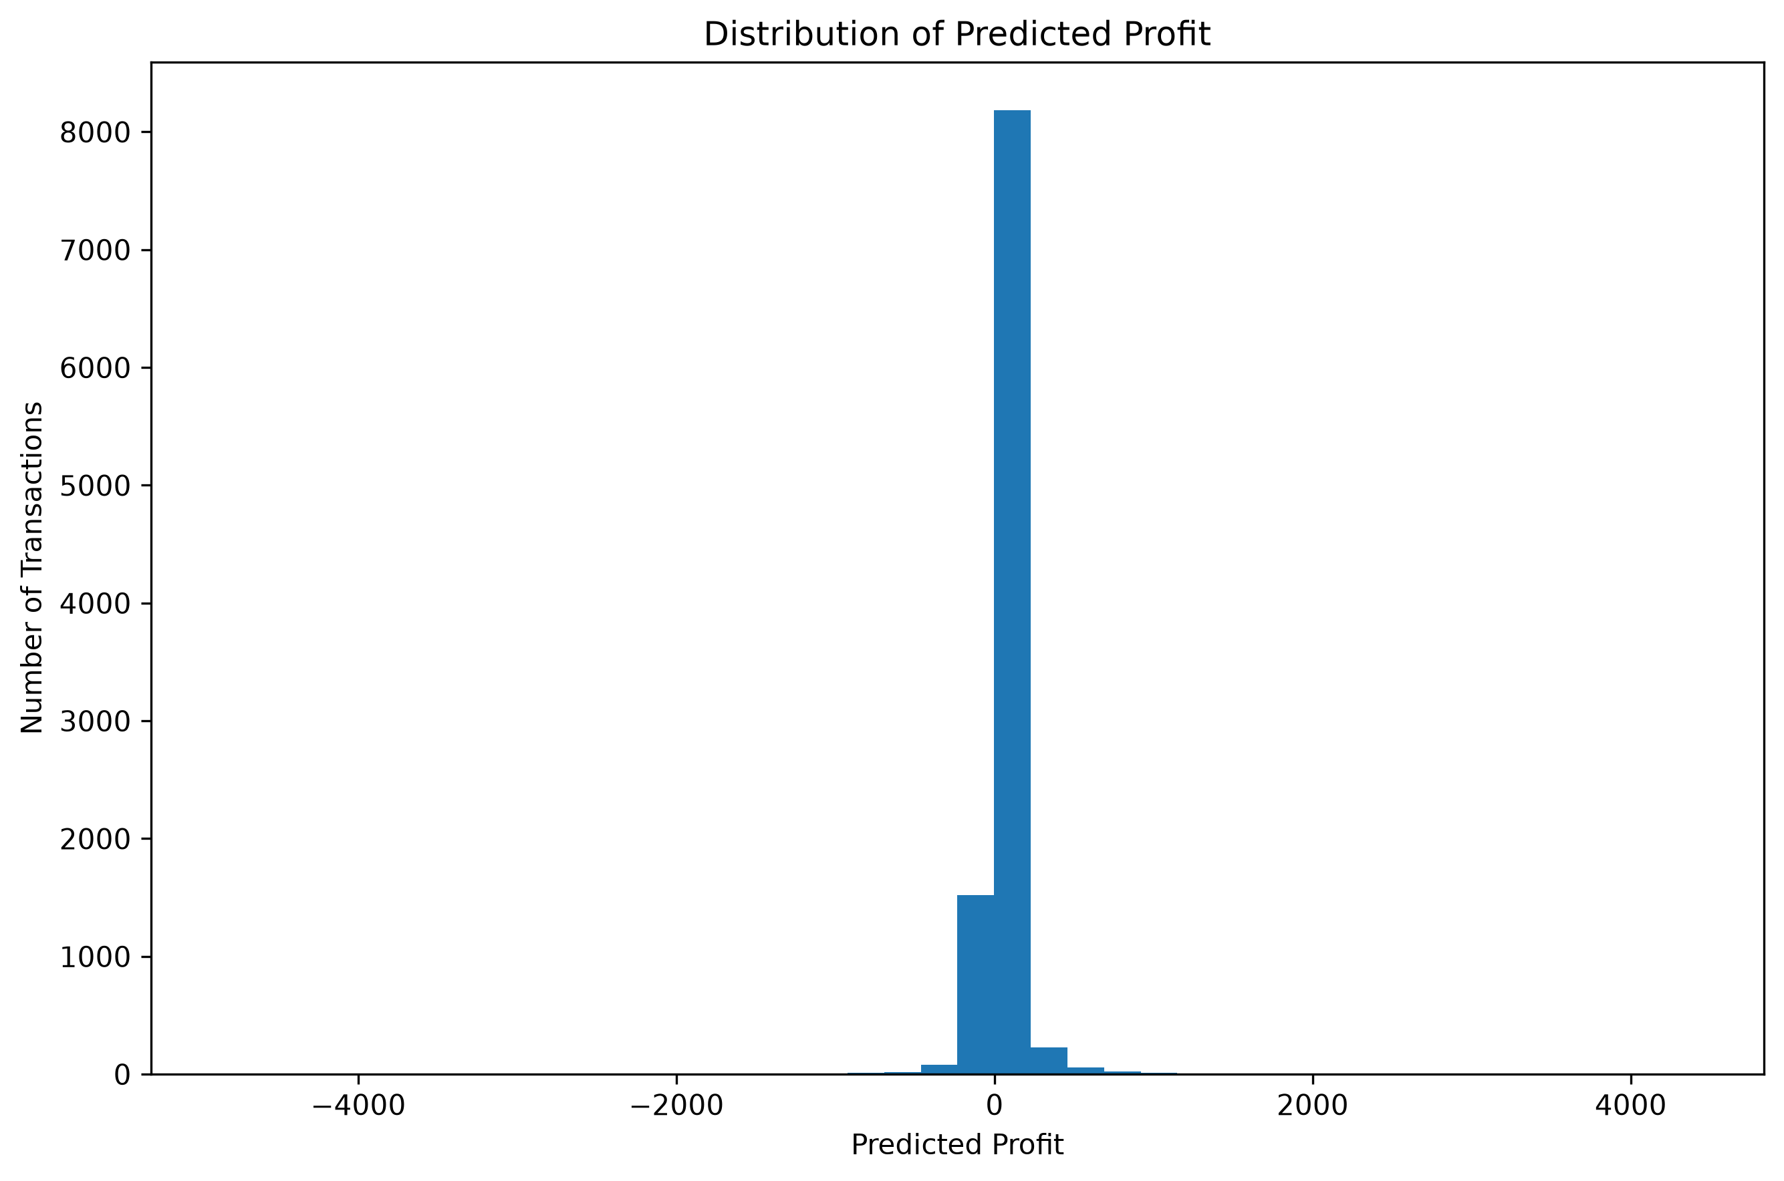
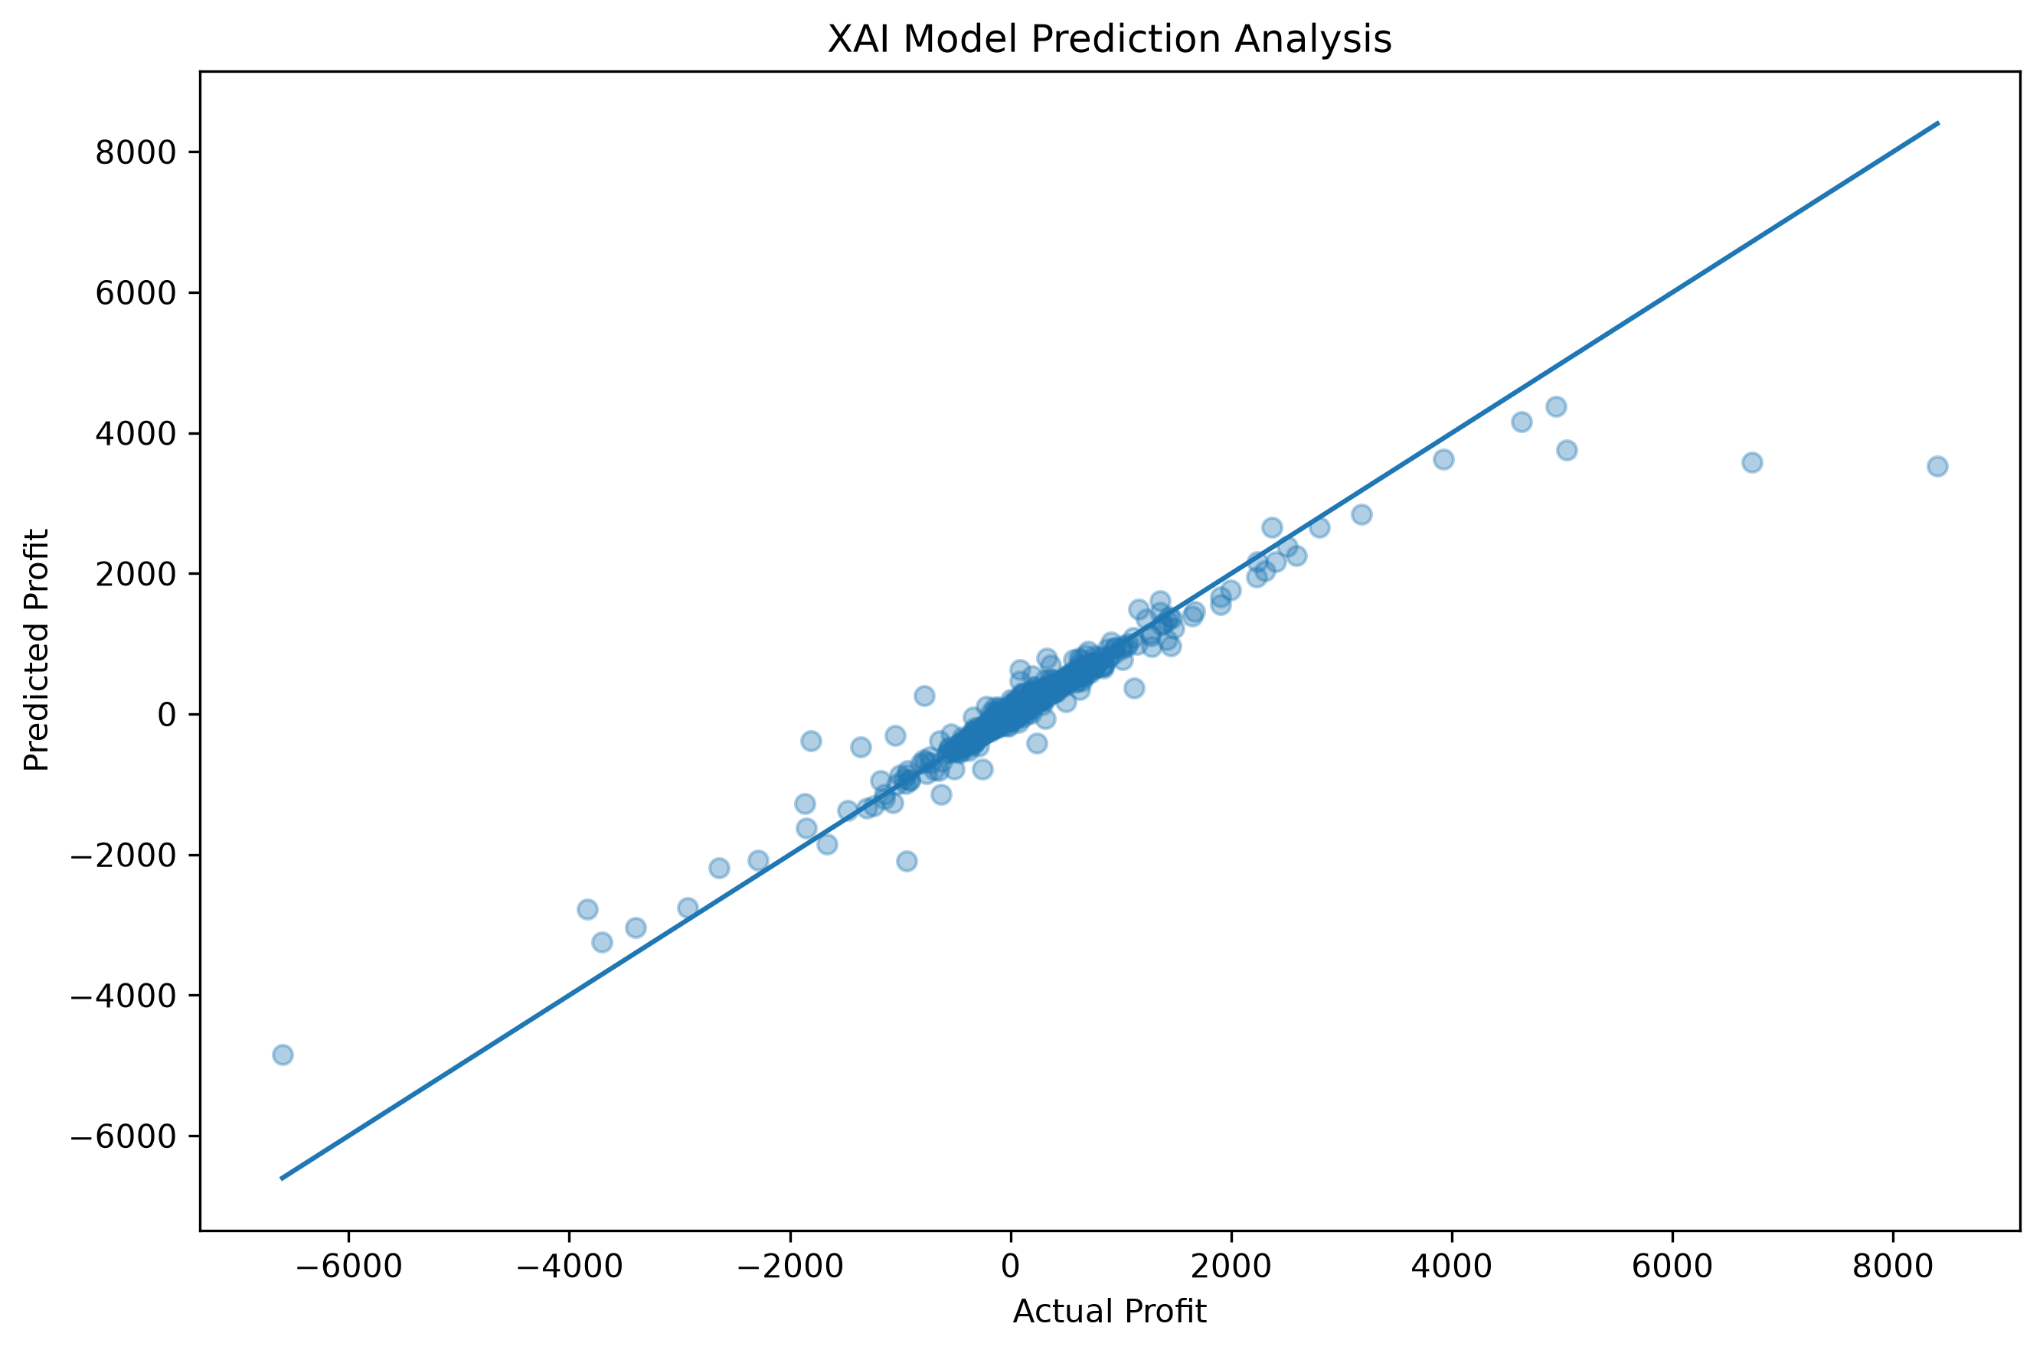
D1 RESULTS: PREDICTION FIT AND ERROR
Actual versus predicted profit
Comparative actual versus predicted
Predicted-profit distribution
XAI analysis prediction fit
REVIEW 3 | AI-ASSISTED DATA VISUALIZATION FOR BUSINESS DECISION SUPPORT
23

Slide 24
D2 RESULTS: COMPARATIVE PROFIT REGRESSION
Values transcribed from results/d2_comparative_model_results.csv.
Model | MAE ↓ | RMSE ↓ | sMAPE ↓ | R² ↑ | Avg rank
Gradient Boosting | 35.58 | 94.12 | 69.76% | 0.667 | 1.50
Hybrid 5 - Validation Optimized Ensemble | 35.58 | 94.12 | 69.76% | 0.667 | 1.50
Hybrid 1 - RF + GB | 37.17 | 99.80 | 71.76% | 0.626 | 3.40
Hybrid 6 - GB + Ridge Residual Correction | 38.10 | 94.21 | 82.35% | 0.666 | 4.20
Random Forest - Selected Features | 40.95 | 110.39 | 76.33% | 0.542 | 5.00
Hybrid 4 - RF + GB + Ridge | 42.45 | 108.97 | 87.12% | 0.554 | 6.00
Random Forest | 43.23 | 116.44 | 80.72% | 0.490 | 6.80
Hybrid 3 - Ridge + GB | 45.04 | 110.68 | 92.93% | 0.540 | 7.80
In the saved D2 comparison, Gradient Boosting is strongest overall; the validation-optimized candidate collapses to the same single model.
REVIEW 3 | AI-ASSISTED DATA VISUALIZATION FOR BUSINESS DECISION SUPPORT
24

Slide 25
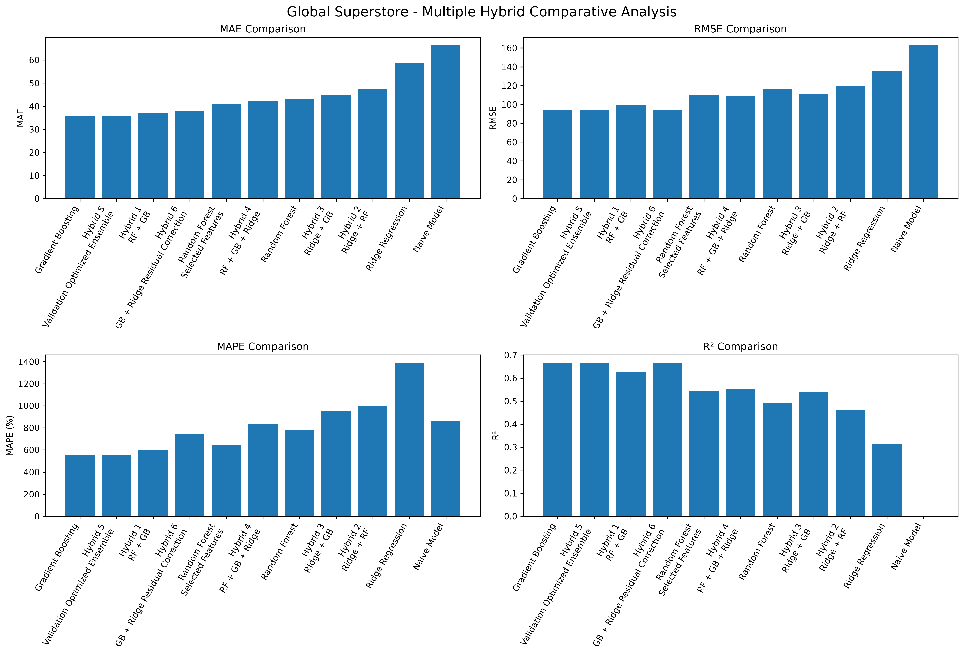
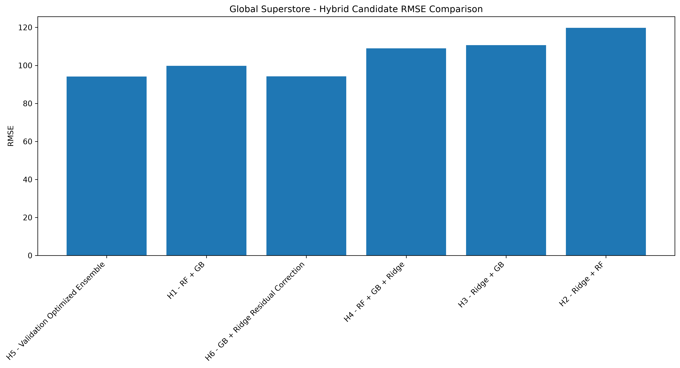
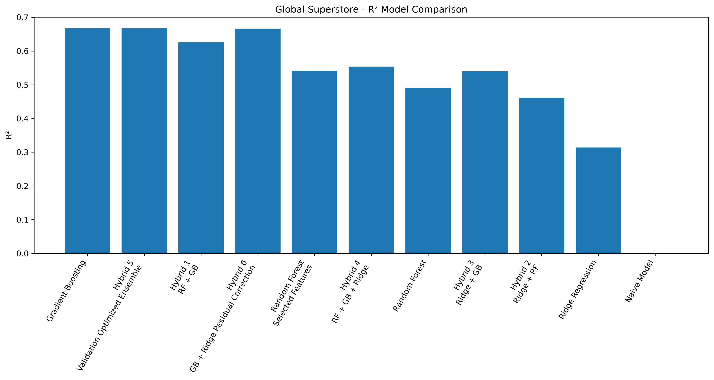
D2 RESULTS: MODEL COMPARISON VISUALS
D2 comparative metrics
D2 hybrid candidate comparison
D2 R² comparison
REVIEW 3 | AI-ASSISTED DATA VISUALIZATION FOR BUSINESS DECISION SUPPORT
25

Slide 26
HYBRID SEARCH: WHAT THE EARLIER EXPERIMENTS SHOW
Dataset | Best baseline | Best genuine hybrid in prior candidate set | Evidence-based conclusion
D1 | Gradient Boosting: MAE 21.70, RMSE 93.73, R² 0.837 | RF + GB: MAE 24.50, RMSE 102.28, R² 0.806 | Hybrid does not beat best baseline on MAE/RMSE/R² collectively.
D2 | Gradient Boosting: MAE 35.58, RMSE 94.12, R² 0.667 | RF + GB: MAE 37.17, RMSE 99.80, R² 0.626 | Hybrid does not beat best baseline in the reported comparison.
Important
Research implication
A validation-optimized ensemble can select 100% of one model.
Do not claim hybrid superiority without consistent evidence.
REVIEW 3 | AI-ASSISTED DATA VISUALIZATION FOR BUSINESS DECISION SUPPORT
26

Slide 27
ADDITIONAL D1 EXPERIMENT: RESIDUAL HYBRID
Actual results from results/d1_final_hybrid_results.csv; this experiment uses its own 80/10/10 sequential split.
Model | MAE ↓ | RMSE ↓ | sMAPE ↓ | R² ↑ | Parameter
Hybrid 1 - GB + RF Residual | 15.65 | 102.80 | 39.23% | 0.835 | 1.0
Random Forest | 17.66 | 131.85 | 38.78% | 0.729 | nan
Hybrid 2 - RF + GB Residual | 17.66 | 131.85 | 38.78% | 0.729 | 0.0
Gradient Boosting | 23.44 | 106.96 | 72.91% | 0.822 | nan
Hybrid 4 - Constrained GB+RF+Ridge | 21.27 | 125.33 | 65.54% | 0.755 | GB=0.4, RF=0.5, Ridge=0.1
Hybrid 3 - GB + Ridge Residual | 24.14 | 107.46 | 77.47% | 0.820 | 1.0
Ridge Regression | 59.16 | 234.40 | 118.60% | 0.143 | nan
GB + RF residual correction has the best average rank in this additional D1 experiment, but its RMSE is not the lowest. Compare only within this experiment's split.
REVIEW 3 | AI-ASSISTED DATA VISUALIZATION FOR BUSINESS DECISION SUPPORT
27

Slide 28
HYBRID SELECTION: FAIRNESS AND LIMITATIONS
• Different saved experiment files may reflect different split strategies and should not be compared as if they were one experiment.
• Residual correction can improve one metric while worsening another; selection needs a predeclared primary metric or justified multi-metric rule.
• MAPE can become unstable when actual profit is near zero; report it with MAE, RMSE, sMAPE and R².
• Hybrid weights that assign zero to components are effectively single-model results, not genuine multi-model combinations.
• Statistical significance and robustness require repeated seeds or suitable paired tests; average rank alone does not establish significance.
Final proposed hybrid is not yet declared superior; additional consistent validation and novelty review are required.
REVIEW 3 | AI-ASSISTED DATA VISUALIZATION FOR BUSINESS DECISION SUPPORT
28

Slide 29
D3 CLUSTERING: METHODS AND INPUTS
Input representation
Methods compared
Internal metrics
• ZIP-code prefix
• State encoded categorically
• Standardized numeric feature space
• Deterministic 25,000-row evaluation sample
• K-Means (k = 2–8)
• Agglomerative (k = 2–8)
• Gaussian Mixture (k = 2–8)
• DBSCAN parameter grid
• Silhouette: higher is better
• Davies–Bouldin: lower is better
• Calinski–Harabasz: higher is better
• Interpret together with geographic meaning
This is geographic segmentation—not purchase-frequency, lifetime-value or behavioural segmentation.
REVIEW 3 | AI-ASSISTED DATA VISUALIZATION FOR BUSINESS DECISION SUPPORT
29

Slide 30
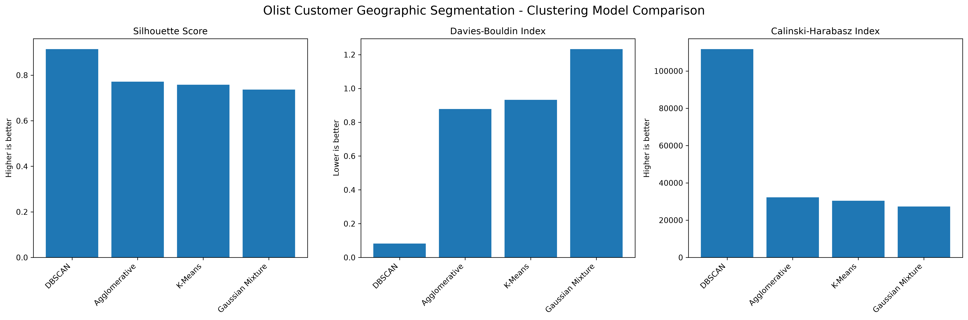
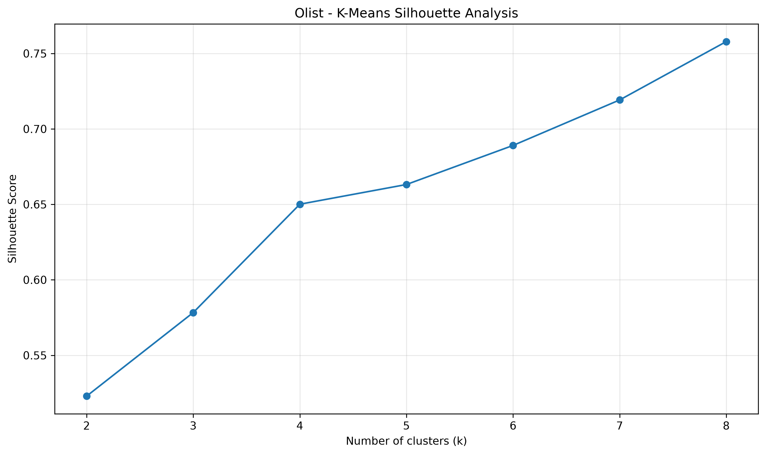
D3 RESULTS: CLUSTERING MODEL COMPARISON
Method | Clusters | Noise | Silhouette ↑ | Davies–Bouldin ↓ | Calinski–Harabasz ↑
DBSCAN (eps=0.30, min_samples=5) | 27 | 0 | 0.9143 | 0.0820 | 111,738.4
Agglomerative (k=8) | 8 | 0 | 0.7714 | 0.8786 | 32,228.4
K-Means (k=8) | 8 | 0 | 0.7579 | 0.9323 | 30,377.5
Gaussian Mixture (k=8) | 8 | 0 | 0.7367 | 1.2327 | 27,291.7
Saved clustering comparison
K-Means silhouette by k
REVIEW 3 | AI-ASSISTED DATA VISUALIZATION FOR BUSINESS DECISION SUPPORT
30

Slide 31
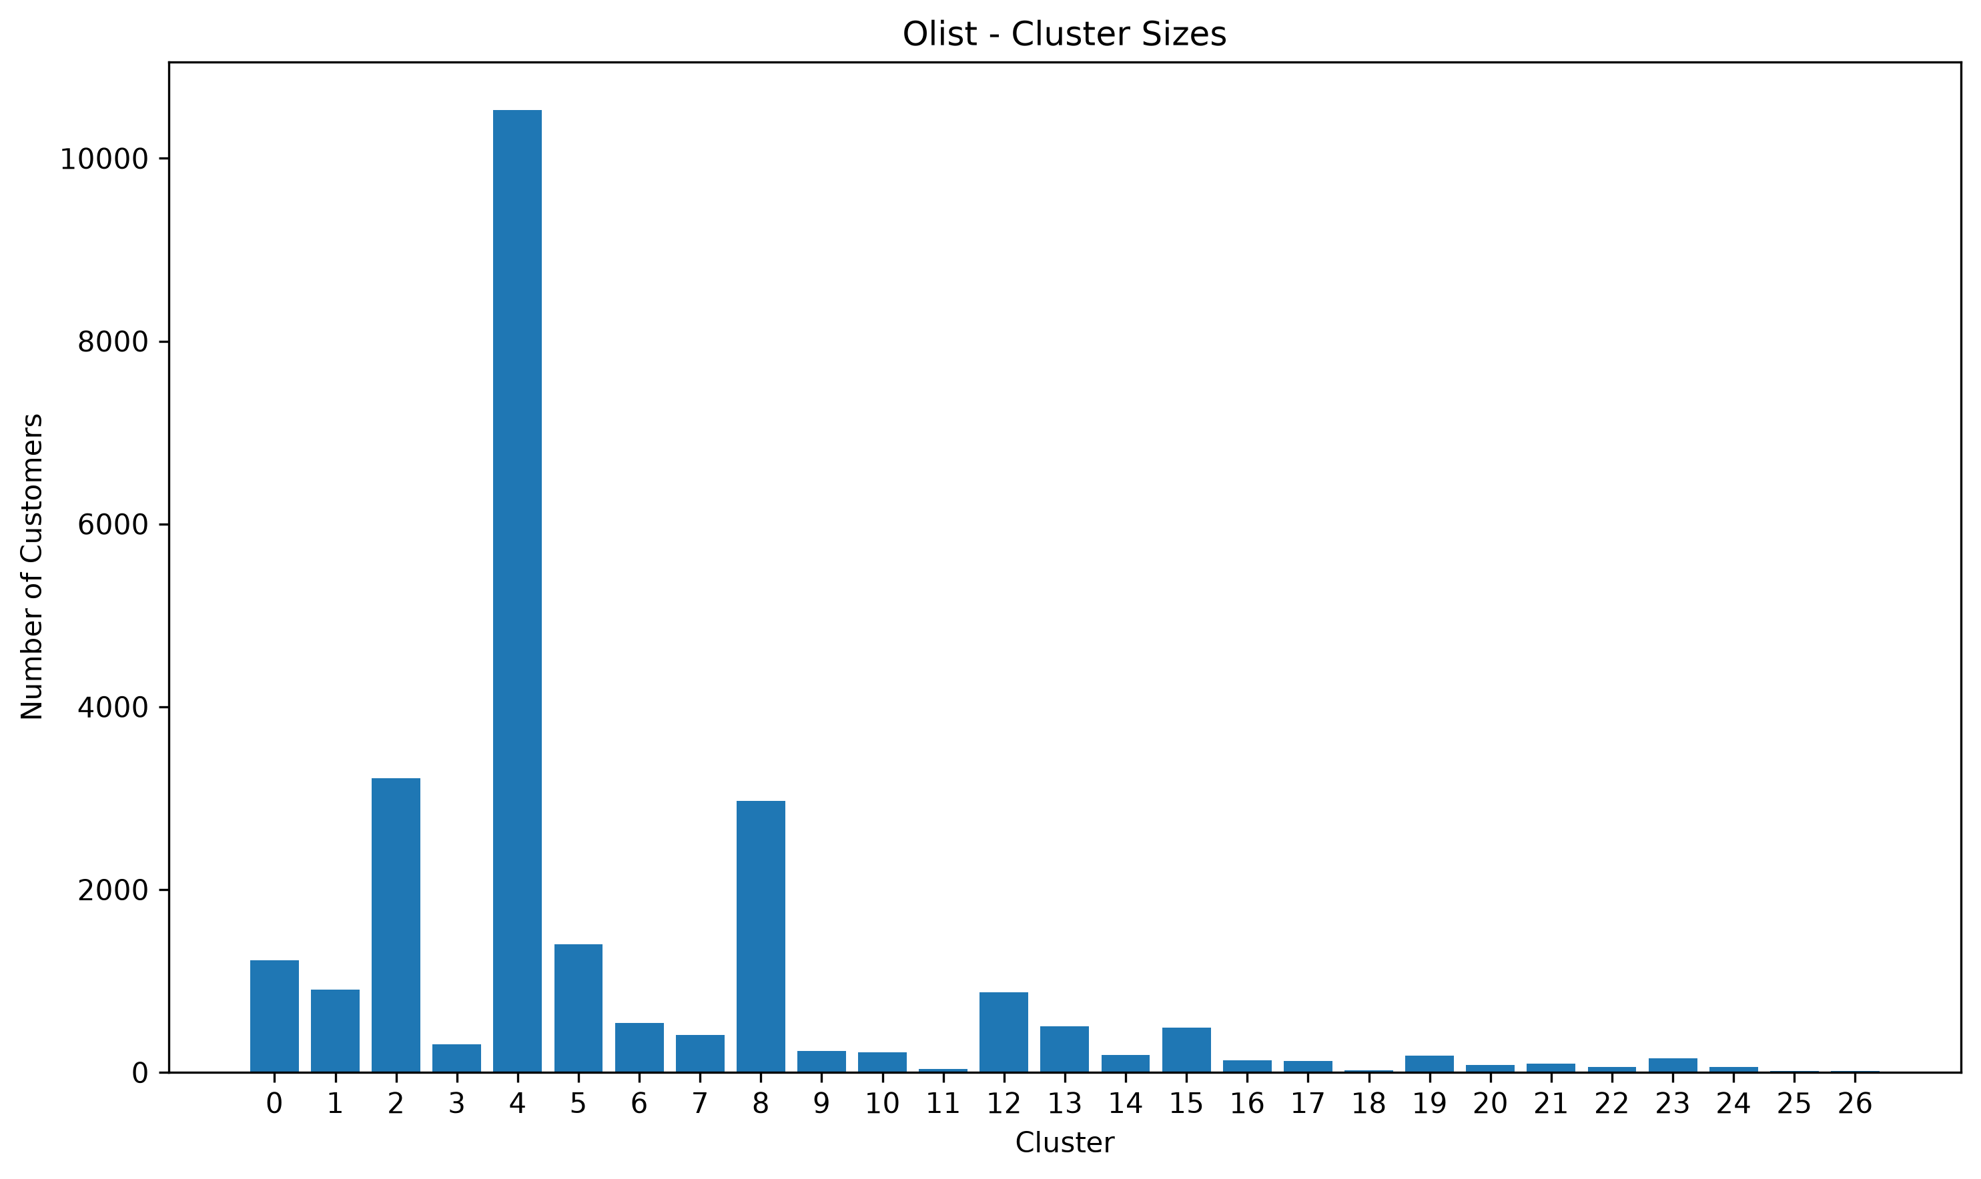
D3 RESULTS: DBSCAN PARAMETER CHECK
Configuration | Clusters | Noise points | Silhouette | Davies–Bouldin
DBSCAN (eps=0.30, min_samples=5) | 27 | 0 | 0.9143 | 0.0820
DBSCAN (eps=0.30, min_samples=10) | 27 | 0 | 0.9143 | 0.0820
DBSCAN (eps=0.40, min_samples=5) | 27 | 0 | 0.9143 | 0.0820
DBSCAN (eps=0.40, min_samples=10) | 27 | 0 | 0.9143 | 0.0820
DBSCAN (eps=0.50, min_samples=5) | 27 | 0 | 0.9143 | 0.0820
DBSCAN (eps=0.50, min_samples=10) | 27 | 0 | 0.9143 | 0.0820
DBSCAN (eps=0.60, min_samples=5) | 27 | 0 | 0.9143 | 0.0820
Saved cluster-size output
DBSCAN reports 27 clusters and 0 noise points in the saved evaluation; inspect parameter sensitivity and cluster meaning before business use.
REVIEW 3 | AI-ASSISTED DATA VISUALIZATION FOR BUSINESS DECISION SUPPORT
31

Slide 32
D3 RESULTS: EXAMPLE CLUSTER PROFILES
Cluster | Customers | Average ZIP prefix | Median ZIP prefix
0 | 1228 | 84105.2 | 84200.0
1 | 909 | 88827.1 | 88815.0
2 | 3218 | 24007.5 | 23075.0
3 | 307 | 61619.8 | 61650.0
4 | 10529 | 9246.0 | 8730.0
5 | 1399 | 94810.4 | 95300.0
6 | 543 | 71679.3 | 71881.0
7 | 411 | 53600.1 | 54090.0
8 | 2967 | 35216.2 | 35860.0
9 | 231 | 67305.6 | 67118.0
Interpretation
Profiles summarize ZIP-prefix values within assigned clusters; ZIP prefixes are identifiers, not a true distance metric.
Limitation
Geographic validity should be checked against actual coordinates or a suitable geographic distance representation.
REVIEW 3 | AI-ASSISTED DATA VISUALIZATION FOR BUSINESS DECISION SUPPORT
32

Slide 33
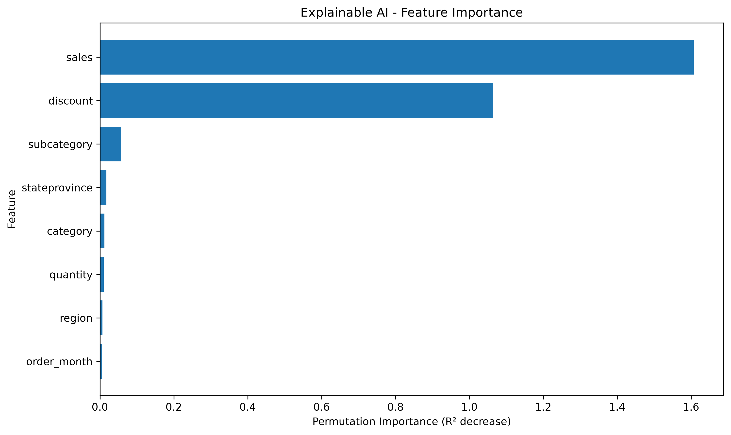
EXPLAINABLE AI: PERMUTATION FEATURE IMPORTANCE
Rank | Feature | Mean | Std
1 | sales | 1.6078 | 0.0556
2 | discount | 1.0649 | 0.0662
3 | subcategory | 0.0568 | 0.0018
4 | stateprovince | 0.0175 | 0.0019
5 | category | 0.0120 | 0.0012
6 | quantity | 0.0101 | 0.0012
7 | region | 0.0066 | 0.0015
8 | order_month | 0.0063 | 0.0017
Saved permutation importance plot
Sales and discount dominate the saved D1 importance values. Importance indicates model reliance, not causal effect.
REVIEW 3 | AI-ASSISTED DATA VISUALIZATION FOR BUSINESS DECISION SUPPORT
33

Slide 34
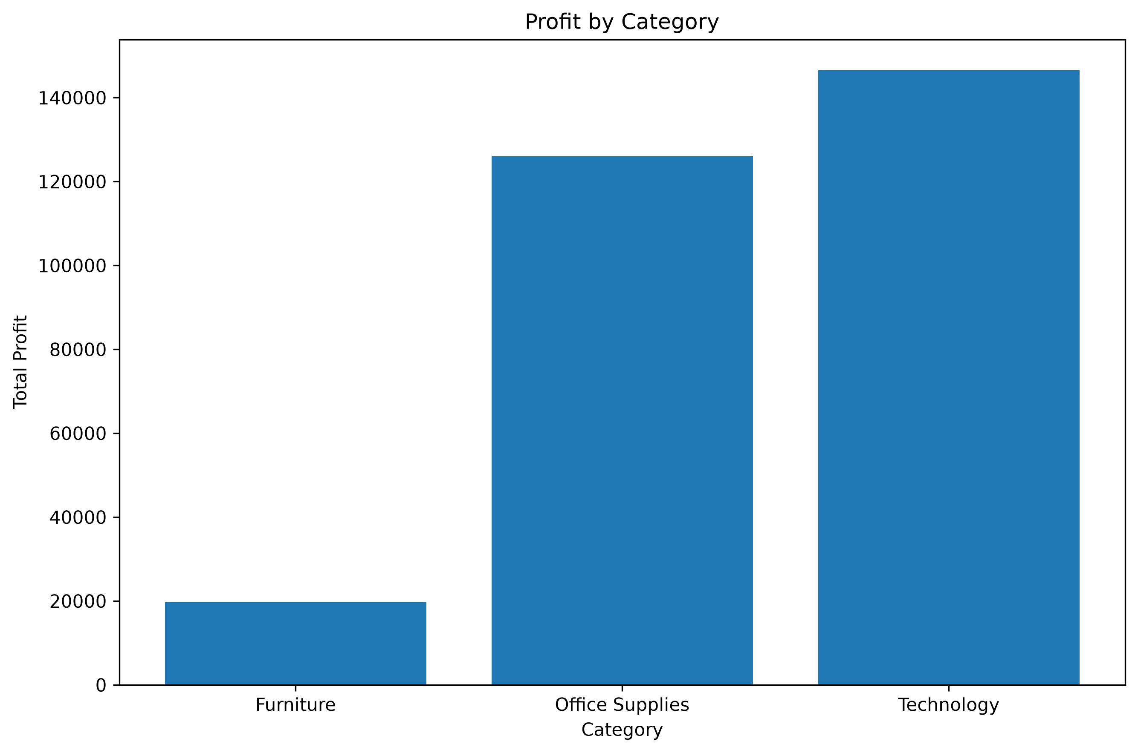
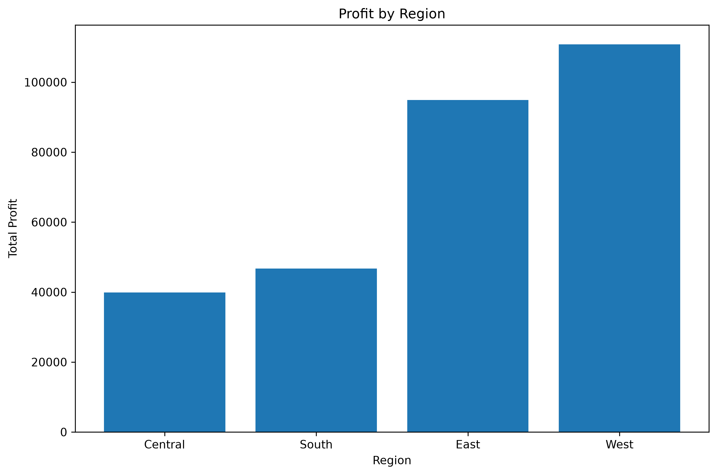
BUSINESS SUMMARY: KEY PERFORMANCE INDICATORS
$2.33M
$292.3K
38,654
15.54%
Total sales
Total profit
Total quantity
Average discount
Profit by category
Profit by region
REVIEW 3 | AI-ASSISTED DATA VISUALIZATION FOR BUSINESS DECISION SUPPORT
34

Slide 35
BUSINESS INSIGHTS: CATEGORY AND REGION
Category | Sales | Profit | Avg disc. | Margin
Technology | $839,893 | $146,543 | 13.1% | 17.4%
Office Supplies | $731,893 | $126,023 | 15.6% | 17.2%
Furniture | $754,748 | $19,730 | 17.3% | 2.6%
Region | Sales | Profit | Avg disc.
West | $739,814 | $110,799 | 10.9%
East | $691,828 | $94,883 | 14.3%
South | $391,722 | $46,749 | 14.7%
Central | $503,171 | $39,865 | 24.1%
Category observation
Regional observation
Technology reports the highest total profit (~$146.5K); Furniture reports the lowest (~$19.7K).
West reports the highest total profit (~$110.8K) in the saved business summary.
These are descriptive dataset findings, not causal conclusions or universal business rules.
REVIEW 3 | AI-ASSISTED DATA VISUALIZATION FOR BUSINESS DECISION SUPPORT
35

Slide 36
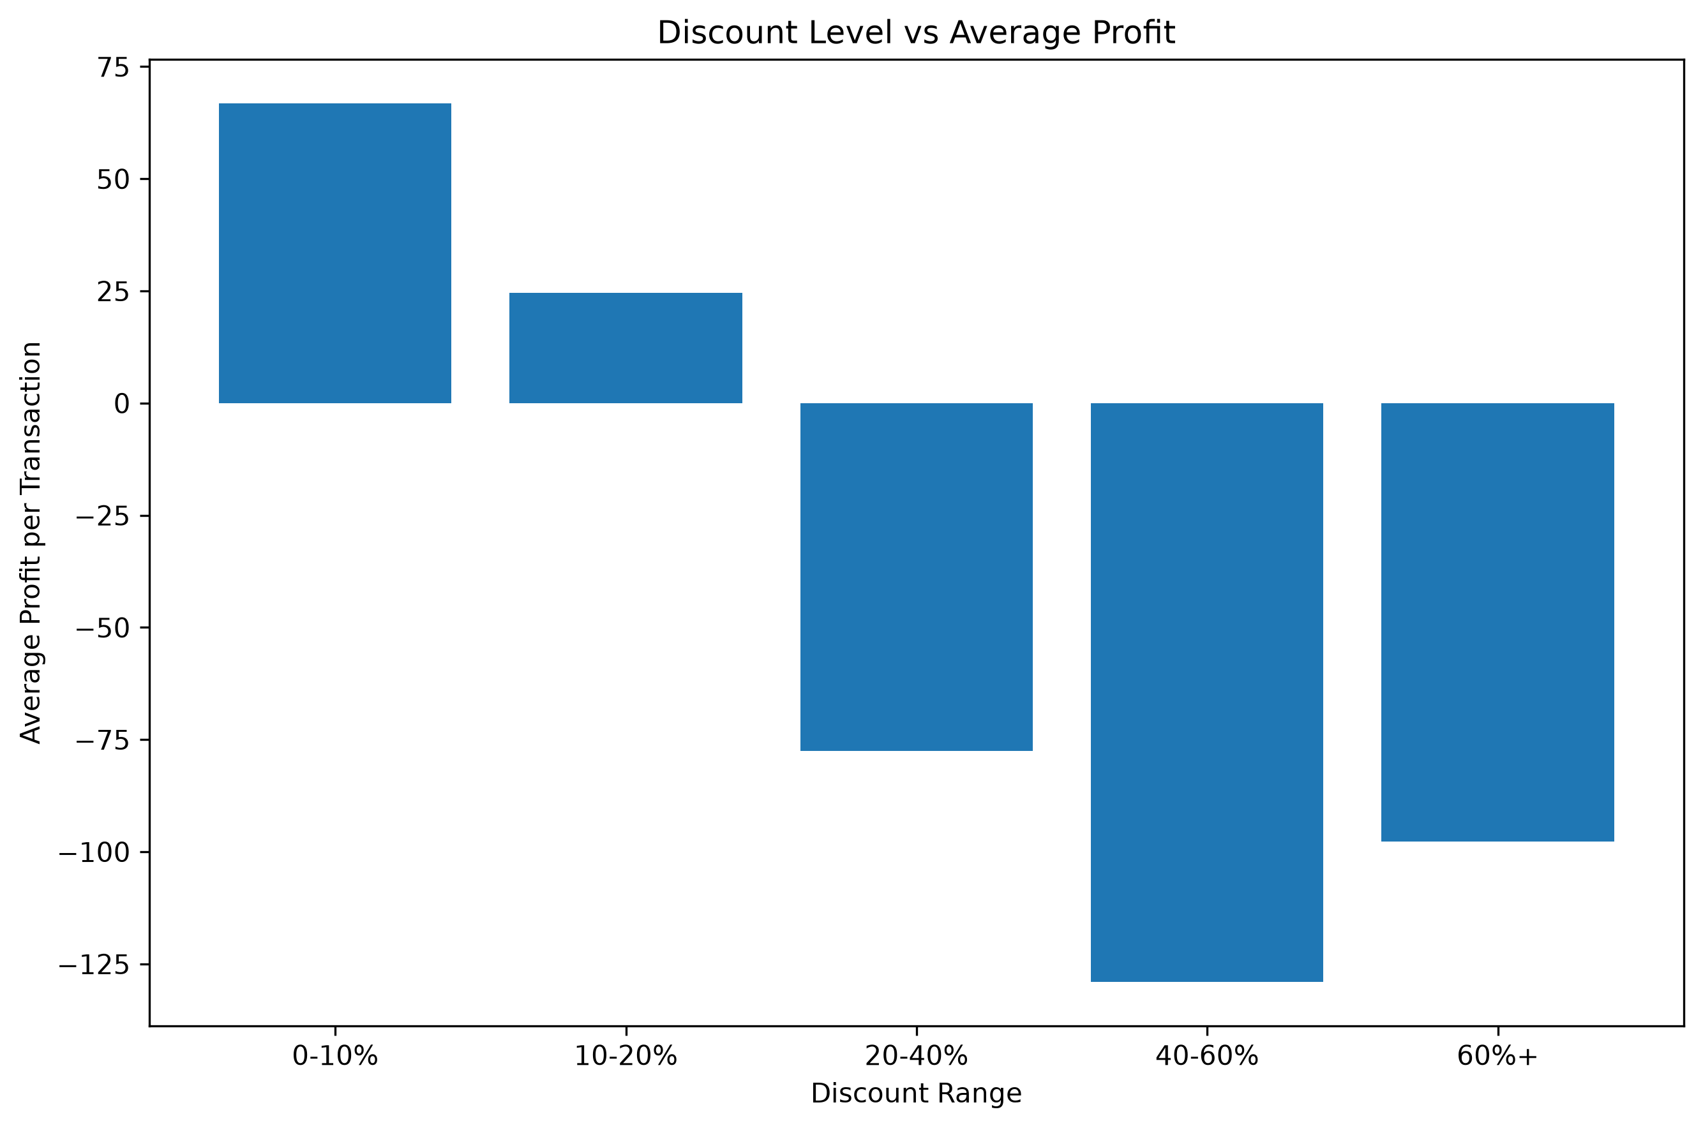
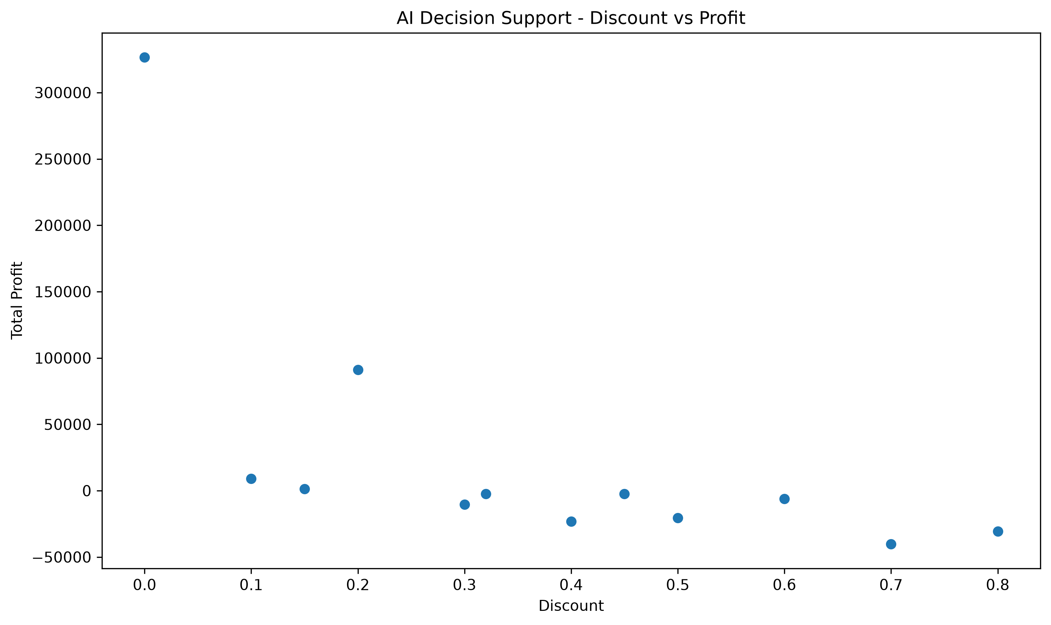
BUSINESS INSIGHTS: DISCOUNT AND SUBCATEGORY RISK
Discount band | Sales | Profit | Avg profit | Records
0-10% | $1,160,276 | $335,819 | $66.88 | 5021
10-20% | $801,498 | $92,499 | $24.61 | 3758
20-40% | $235,465 | $-35,991 | $-77.57 | 464
40-60% | $71,509 | $-29,164 | $-129.04 | 226
60%+ | $57,785 | $-70,866 | $-97.75 | 725
Subcategory | Profit | Avg discount
Tables | $-17,753 | 25.8%
Bookcases | $-3,632 | 21.5%
Supplies | $-1,171 | 7.6%
Fasteners | $2,429 | 7.9%
Machines | $3,462 | 30.4%
Labels | $5,573 | 7.1%
Discount versus profit
DSS discount-profit view
REVIEW 3 | AI-ASSISTED DATA VISUALIZATION FOR BUSINESS DECISION SUPPORT
36

Slide 37
DASHBOARD: APPLICATION STRUCTURE AND VALIDATION
Navigation modules
Dataset-aware behaviour
Before claiming validated
• Overview
• Analytics
• Profit Prediction
• Explainable AI
• Recommendations
• ML Models & Algorithms
• Ask AI
• D1/D2: profit regression
• D3: geographic segmentation
• KPI and trend views
• Model metrics and explanations
• Business recommendations
• Clean startup
• Verify all pages
• Test predictions per dataset
• Inspect charts and errors
• Capture actual dashboard screenshots
• Confirm no broken paths
Replace mock-ups in the final oral presentation with screenshots from the actual running Streamlit app.
REVIEW 3 | AI-ASSISTED DATA VISUALIZATION FOR BUSINESS DECISION SUPPORT
37

Slide 38
IMPLEMENTATION, REPRODUCIBILITY AND REPOSITORY
Implemented artefacts
Evidence to finalize
• Cleaning and EDA scripts
• Feature-selection results
• Baseline and comparative model results
• Hybrid candidate experiments
• XAI importance and prediction explanations
• Business recommendation summaries
• D3 clustering model/parameter results
• Record package versions and random seeds
• Rerun scripts and match saved CSVs
• Document train/validation/test protocol
• Commit source, requirements and output artifacts
• Add README with run instructions
• Add repository URL and commit/version in slides
A saved output file is evidence of an earlier run; reproducibility requires a documented rerun.
REVIEW 3 | AI-ASSISTED DATA VISUALIZATION FOR BUSINESS DECISION SUPPORT
38

Slide 39
RESEARCH PAPER STATUS, LIMITATIONS AND NEXT STEPS
Paper should contain
Remaining checks
• Literature matrix: method formation, data, baselines, metrics, contribution and limitation
• EDA and feature-selection figures
• Baseline/hybrid metric tables
• Clustering comparison and profiles
• XAI and business findings
• Reproducibility and declarations
• Final hybrid experiment for D2
• Consistent split and fair comparison
• Verify DOI/full reference metadata
• Novelty check before making contribution claim
• Dashboard screenshot and end-to-end validation
• GitHub update and plagiarism/similarity check
Do not report unsupported novelty or superiority; clearly label any remaining work.
REVIEW 3 | AI-ASSISTED DATA VISUALIZATION FOR BUSINESS DECISION SUPPORT
39

Slide 40
CONCLUSION: EVIDENCE-BASED STATUS
Data and workflow
Model findings
Decision support
Three datasets are prepared; D1/D2 use profit regression and D3 uses geographic segmentation.
Gradient Boosting leads the completed earlier D1/D2 comparison; the hybrid search is ongoing and does not yet establish consistent superiority.
Feature importance and descriptive business summaries connect the model workflow to interpretable outputs.
Next: finalize consistent hybrid experiments → verify novelty → validate dashboard → synchronize PPT and paper → update repository.
The final proposed model will be selected only when measured evidence supports the decision.
REVIEW 3 | AI-ASSISTED DATA VISUALIZATION FOR BUSINESS DECISION SUPPORT
40

Slide 41
SELECTED REFERENCES FOR THE MODEL STUDY
• Lessmann, S., et al. (2021). Targeting customers for profit: An ensemble learning framework to support marketing decision-making. Information Sciences, 557, 286–301. DOI: 10.1016/j.ins.2019.05.027.
• Predicting the Performance of Retail Market Firms: Regression and Machine Learning Methods. Mathematics (2023), 11(8), 1916. DOI: 10.3390/math11081916.
• A Comparative Study of Demand Forecasting Models for a Multi-Channel Retail Company: A Novel Hybrid Machine Learning Approach (2022). DOI: 10.1007/s43069-022-00166-4.
• Applying Machine Learning in Retail Demand Prediction—A Comparison of Tree-Based Ensembles and LSTM-Based Deep Learning. Applied Sciences (2023), 13(19), 11112. DOI: 10.3390/app131911112.
• Regression based hybrid machine learning model performance evaluation on air quality index prediction in Kolkata. Scientific Reports (2026), 16, 26399. DOI: 10.1038/s41598-026-54918-x.
• Project datasets: Superstore Sales; Global Superstore; Olist Brazilian E-Commerce Public Dataset (customer dataset file supplied for this implementation).
Verify complete bibliographic metadata and final citation style before submission.
REVIEW 3 | AI-ASSISTED DATA VISUALIZATION FOR BUSINESS DECISION SUPPORT
41

Slide 42
THANK YOU
Questions, suggestions and feedback
AI-Assisted Data Visualization for
Business Decision Support Systems
G. Harshavardhan Reddy • Ch. Sai Nikhil Reddy • T. Sai Satwik • V. Satya Dev
Under the guidance of Dr. Swapnika | KLH University | A.Y. 2026–2027
42

